Slide 1



Speech modeling and Automatic speech recognition Romain Serizel (Slides by D. Jouvet) LORIA – INRIA - Nancy

Slide 2
Introduction

Slide 3
Information carried by speech
Linguistic content (words)
Speech recognition
Recognition of all uttered words, or just some keywords
➔ Vocal commands, speech transcription, vocal indexing, …
Speaker (who speaks)
Speaker recognition
Speaker identification, or speaker authentication
➔ Diarization (associating speech segments with speakers), …
Language
Language recognition
Identification of the spoken language, or of the dialect, accent, …
Paralinguistic information
Emotions
Neutral speech, joy, sadness, anger, …
Speaking style
Spontaneous vs. read speech, sport commentary, …

Slide 4
Automatic speech recognition (ASR)
In the seventies, rule-based approaches aiming at
Splitting the speech signal into sounds
And, identifying phonemes, then words, then sentences
Since a few decades, data-based learning approaches have spread (data correspond to examples of words or sentences)
Acoustic templates
Recording of a few pronunciations of words that are used as references
➔ Recognition relies on comparing an unknown acoustic form to known reference templates using dynamic programming (DTW: Dynamic Time Warping)
Hidden Markov models (HMM)
Statistical models representing the pronunciation of a phoneme or of a word
➔ Training model parameters, recognition process, structures, adaptation, …
Neural networks
Currently the most efficient and most often used approach
Take benefit of large data sets and computation resources
➔ Application to speech recognition, structures, …

Slide 5
Examples of automatic speech recognition applications
Vocal commands (for environment, voice mail, customer services, …)
Vocal dictation
Automatic transcription of speech data
Vocal assistants
Google assistant, Siri (Apple), Cortana (Microsoft), Alexa (Amazon)
Used on smartphones, or through home devices

Slide 6
Automatic speech recognition

Slide 7
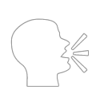
Automatic speech recognition (ASR)
Consists in identifying the words that are pronounced
Sound recording and transmission
Speech recognition system
Recognized words

Slide 8
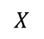
Automatic speech recognition
Sound recording and transmission
Acoustic analysis
Decoding
$$X$$
Recognized words
Acoustic model
Lexicon & pronunciations
Language model
Represents how sounds are pronounced (for one or several speakers, in a given environment)
List of the words known by the system, with their pronunciation variants
Possible sequences of words

Slide 9
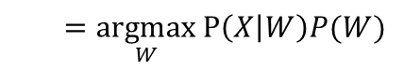
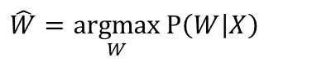

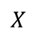

Automatic speech recognition - decoding
Automatic speech recognition system
Speech detection
$$W$$
Speaker
Ambient noises
Sound recording
Trans- mission
Acoustic analysis
$$X$$
Decoding
$$\hat{W}$$
Acoustic channel
Acoustic model
Lexicon & pronunciations
Decoding:
$$\hat{W}=\underset{W}{argmax}{\text{P}\left(W | X\right)}$$
Language model
$=\underset{W}{argmax}{\text{P}\left(X | W\right)P(W)}$
Acoustic model & word pronunciations
Syntax

Slide 10
Automatic speech recognition - modeling
Speech detection
Speaker
Ambient noises
Sound recording
Trans- mission
Acoustic analysis
Decoding
Acoustic model
Training acoustic models
Lexicon & pronunciations
Speech corpus
Acoustic analysis
Estimating parameters
of acoustic models
Language model
Transcription
Selecting vocabulary & word pronunciations
Text corpus
Estimating parameters of language models
Newspapers, web, ….

Slide 11
Content
Speech
Production, perception, sounds of the language, …
Basics of speech recognition
Acoustic analysis
Acoustic templates
Hidden Markov models
Automatic speech recognition
Lexicons, language models, continuous speech recognition
Variability, performances, robustness & adaptation
Deep neural networks
Neural networks, reccurent networks, convolutional networks, ...
Application to acoustic modeling and language modeling
Extracting other information
Para-linguistic information
Speaker and language recognition

Slide 12
Speech
Speech
Basics of speech recognition
Automatic speech recognition
Deep neural networks
Extracting other information

Slide 13
Speech production & perception
Speech
Speech production & perception
Spectral analysis (time-frequency)
Fundamental Frequency & formants
Sounds of the language
Speech signal variability
Basics of speech recognition
Automatic speech recognition
Deep neural networks
Extracting other information

Slide 14
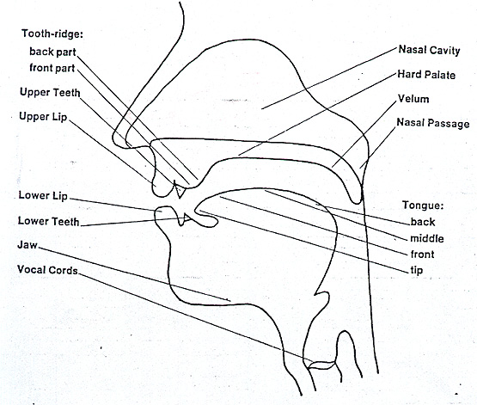
Vocal tract
Velum
Tongue
Vocal cords
Air from the lungs

Slide 15
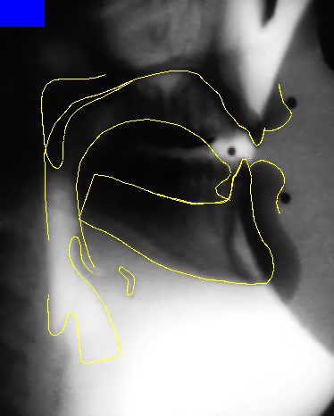
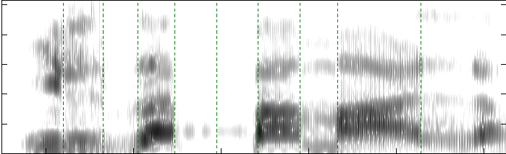

Speech production (French example)
Il zappe pas mal.
⇨

Slide 16
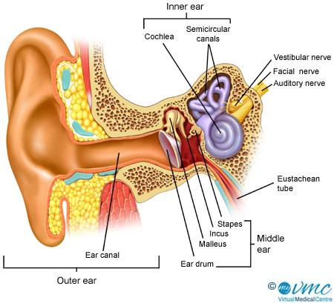
Anatomy of the ear
Inner ear
Cochlea
Auditory nerve
Auditory ossicles
Middle ear
Outer ear

Slide 17
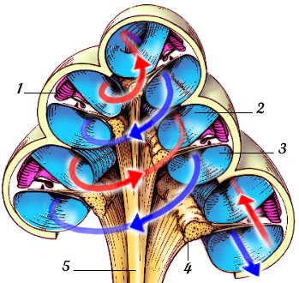

Hearing organ - the cochlea
Cochlea : the cochlea's hollow tube is about 32 mm long and 2 mm in diameter, wrapped like the shell of a snail (about 2.5 times)
Cross section of the cochlea

Slide 18
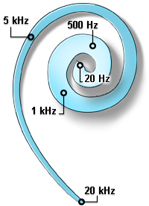


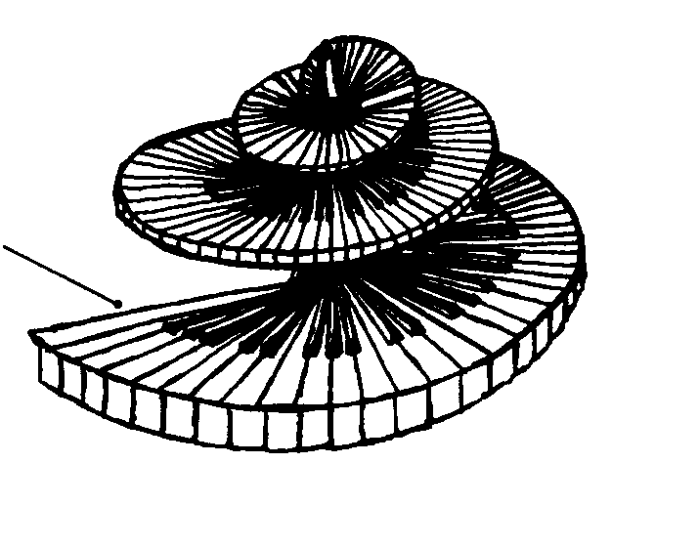
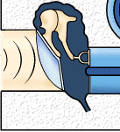




Tonotopy in the auditory system
apex → low frequencies
Basilar membrane
base → high frequencies
Tonotopy ➔ spatial arrangement of where sounds of different frequency are processed
high frequencies are processed near the base
low frequencies are processed near the apex

Slide 19
Auditory perception
Human hear sounds between 30 Hz and 20 kHz limits vary with age, hearing disorders, etc.
With age, there is a progressive loss of the ability to hear high frequencies
Speech sounds frequencies are mainly below 8 kHz
Even when considering only frequencies below 4 kHz, the speech signal is intelligible (e.g., telephone speech)

Slide 20
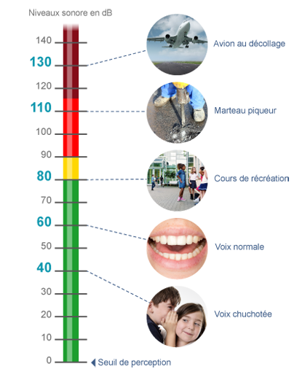
Perception of loudness
Sound level (dB)
Measured in decibels (dB) Logarithmic scale
The perceived loudness vary as the logarithm of the signal energy
Perceived twice as loud ⬄ level 10 dB greater
Jet engine
Jack hammer
Busy city street
Normal voice
Whispering

Slide 21
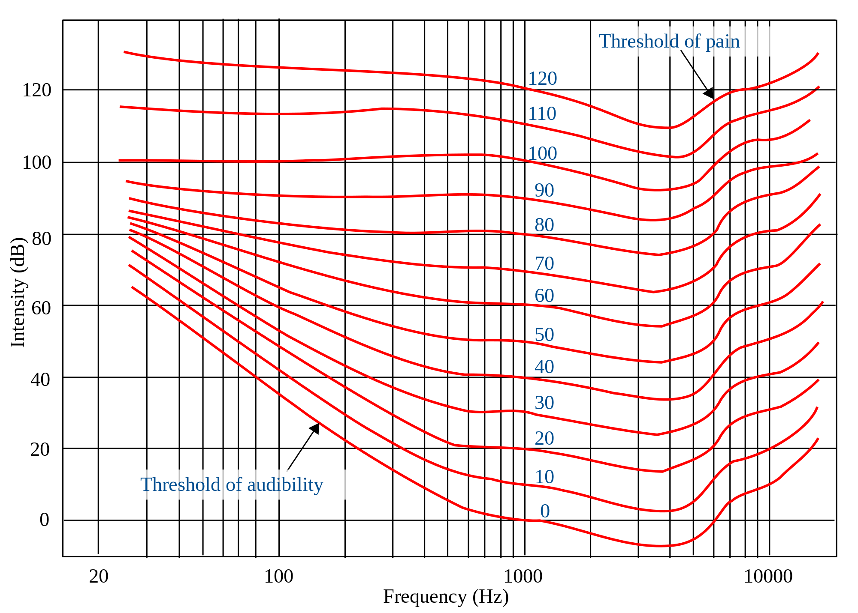
Perception of loudness

Slide 22
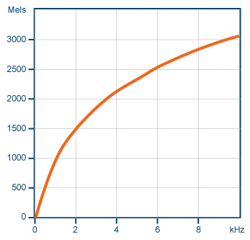
Perception of frequency
The ear is more efficient in the perception of low frequencies than high frequencies
The « mel » scale represents the perception of frequencies
Roughly linear below 500 Hz
Logarithmic above
Mels
kHz

Slide 23
Spectral analysis (time-frequency)
Speech
Speech production & perception
Spectral analysis (time-frequency)
Fundamental Frequency & formants
Sounds of the language
Speech signal variability
Basics of speech recognition
Automatic speech recognition
Deep neural networks
Extracting other information

Slide 24
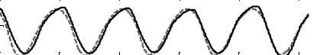
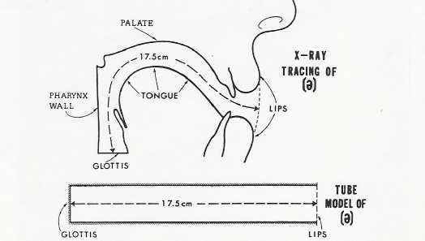
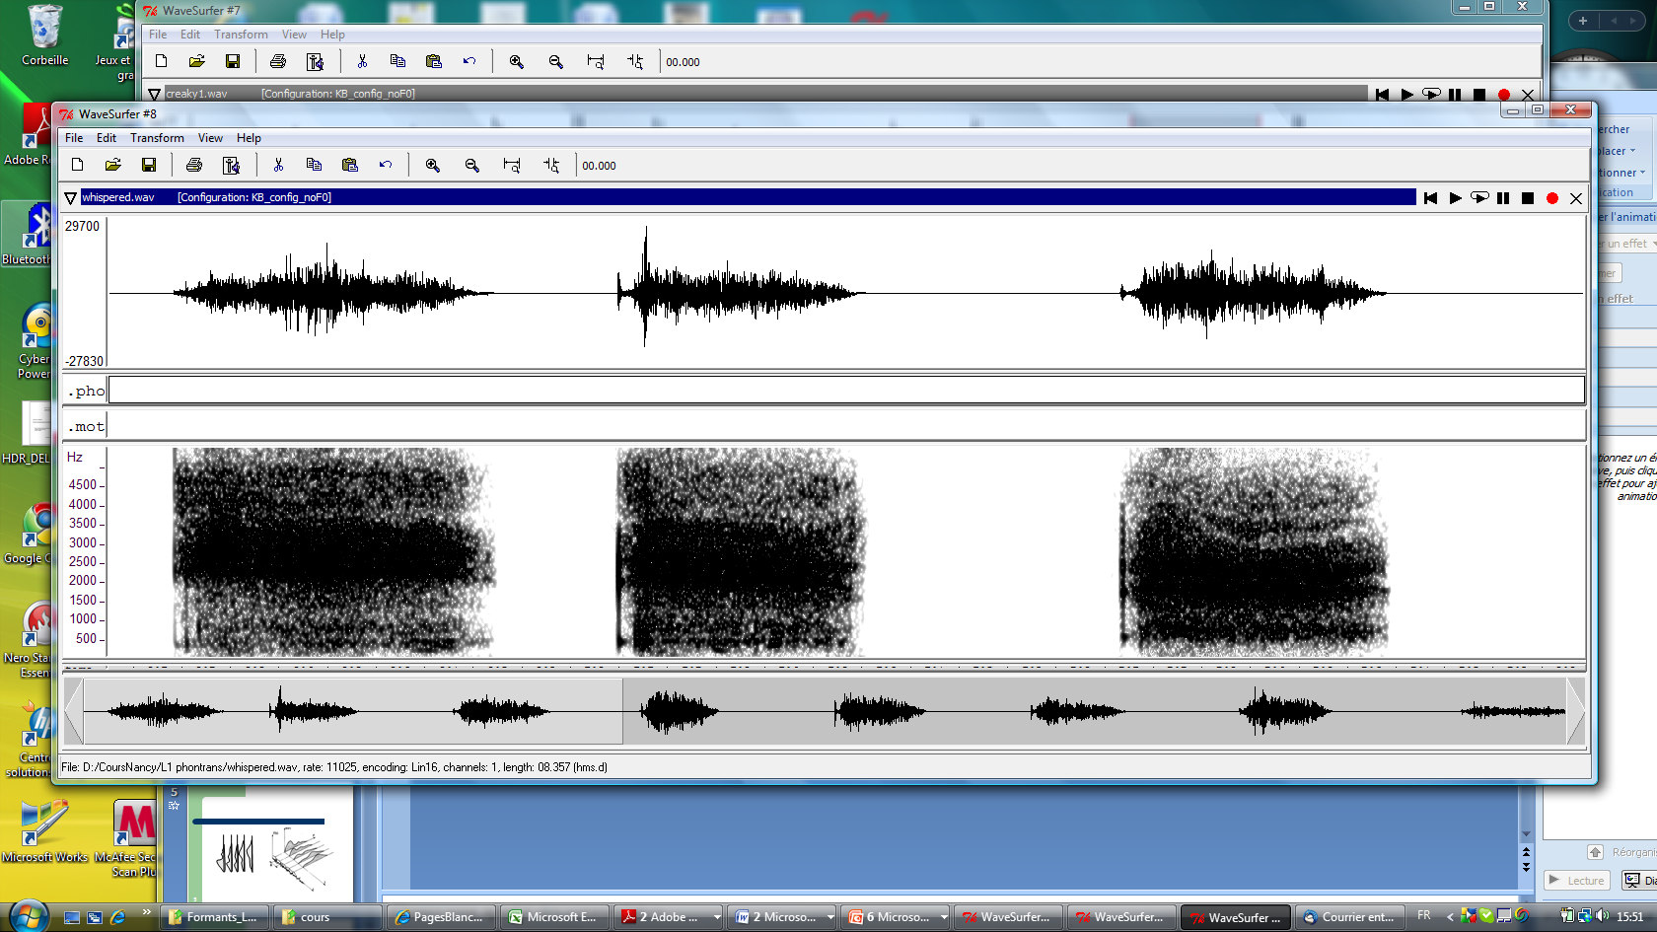
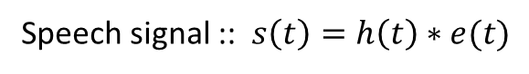
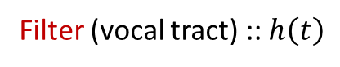
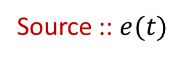
Speech signal
Speech signal
Air flow coming from the lungs and modulated by the vocal tract
Gets to the listeners ear as a pressure wave
Source :: $e(t)$
Filter (vocal tract) :: $h\left(t\right)$
Periodic signal (vibration of the vocal cords)
or
*
Random signal (when vocal cords do not vibrate)
Speech signal :: $s\left(t\right)=h\left(t\right)∗e(t)$

Slide 25
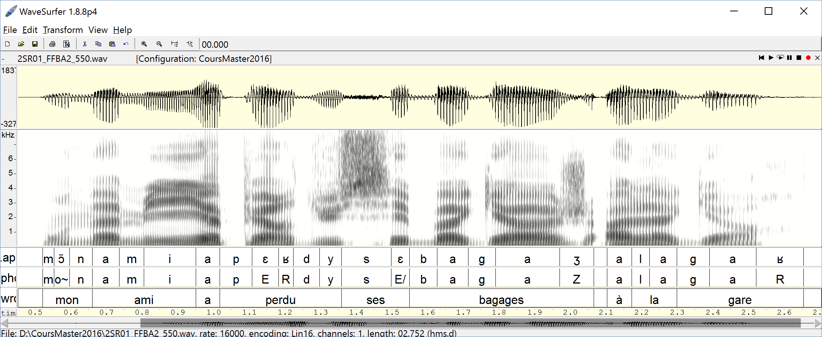
Example of speech signal
Speech signal ⬄ evolution along time of an electrical signal provided by a microphone
Spectrogram ⬄ time – frequency representation of the energy
Signal
Spectrogram
API
SAMPA
Words

Slide 26
Example of speech signal
Speech signal ⬄ evolution along time of an electrical signal provided by a microphone
Spectrogram ⬄ time – frequency representation of the energy
Coding phonemes
IPA ⬄ International Phonetic Alphabet
SAMPA ⬄ « Speech Assessment Methods Phonetic Alphabet » - easier usage in programs (7-bits ascii codes).
Signal
Spectrogram
IPA
SAMPA
Words

Slide 27
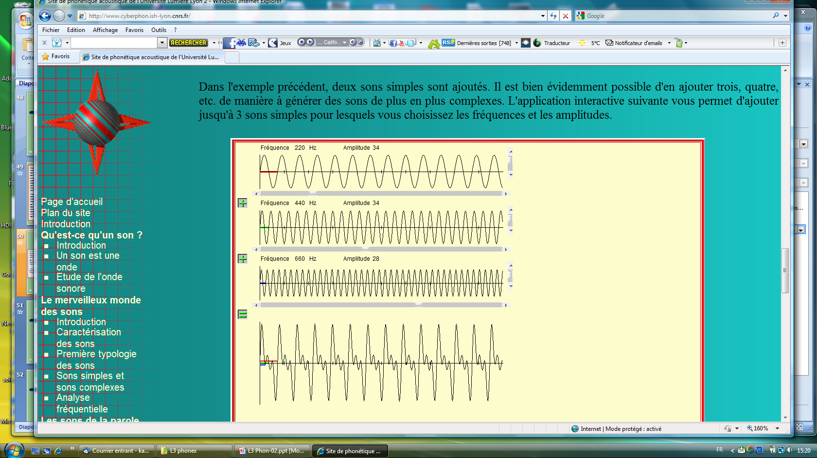
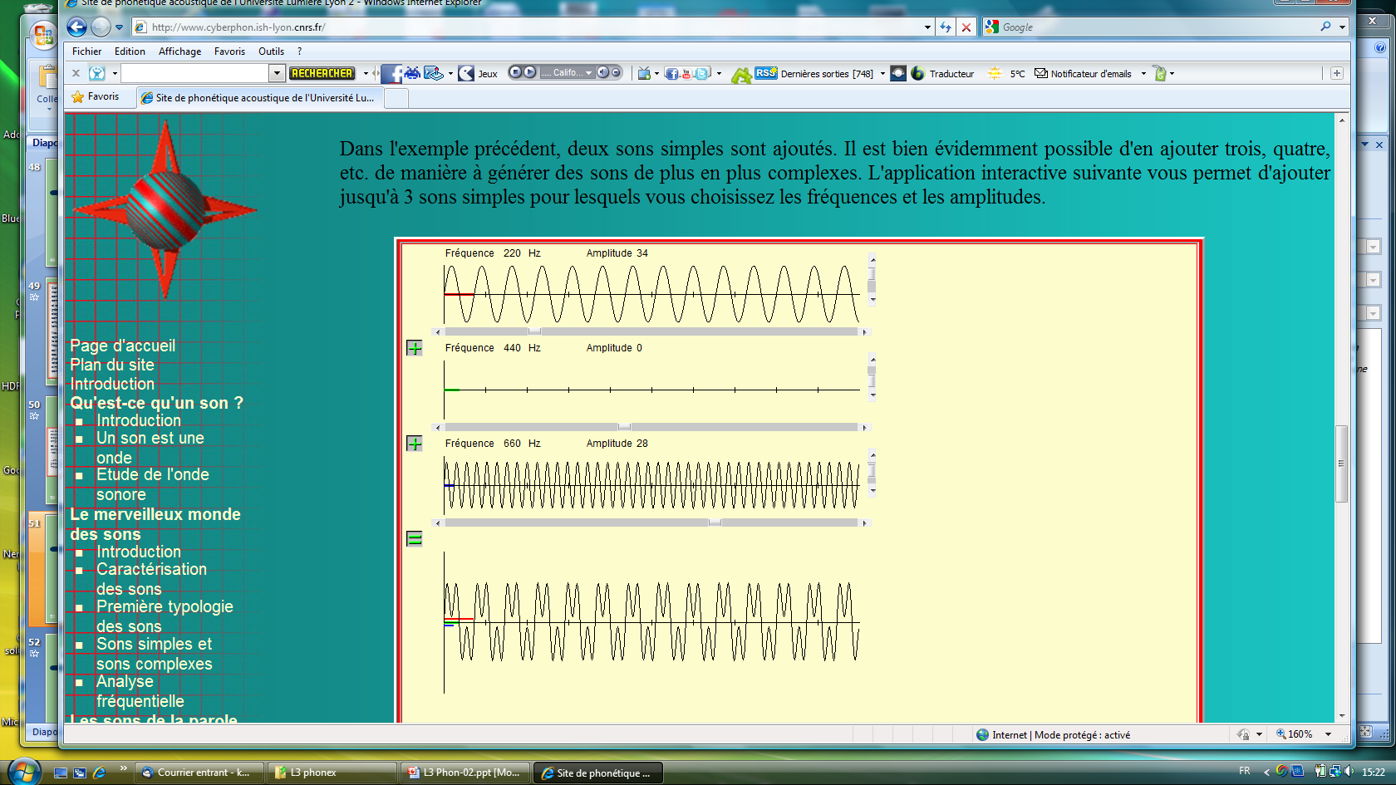
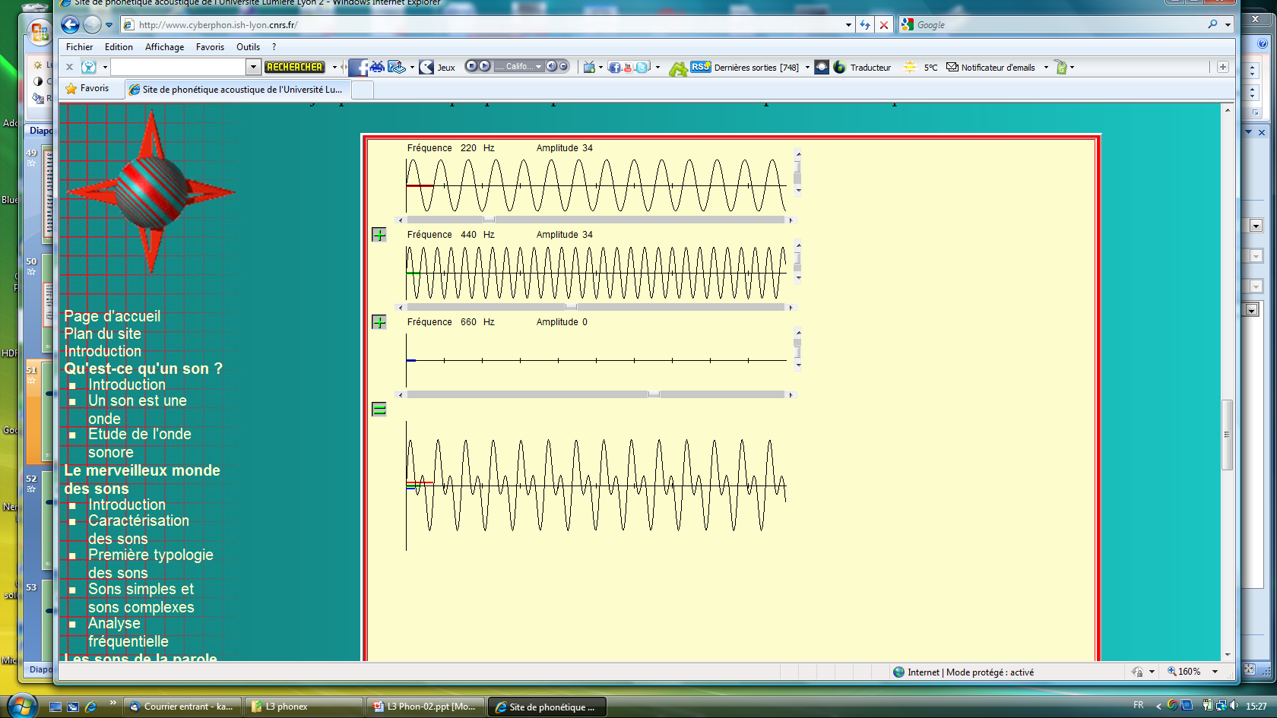
Complex signal
Simple signal
Simple signal
Simple signal
Complex periodic signal
= sum of simple signals (sine waves)
Complex signal

Slide 28
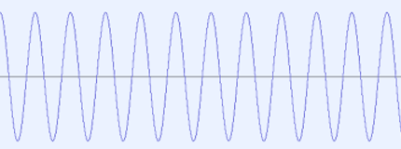
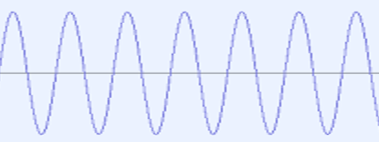
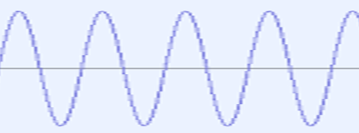
Frequency-domain representation
High frequency = high pitch
Low frequency = low pitch
5kHz
1kHz
440Hz (la)

Slide 29
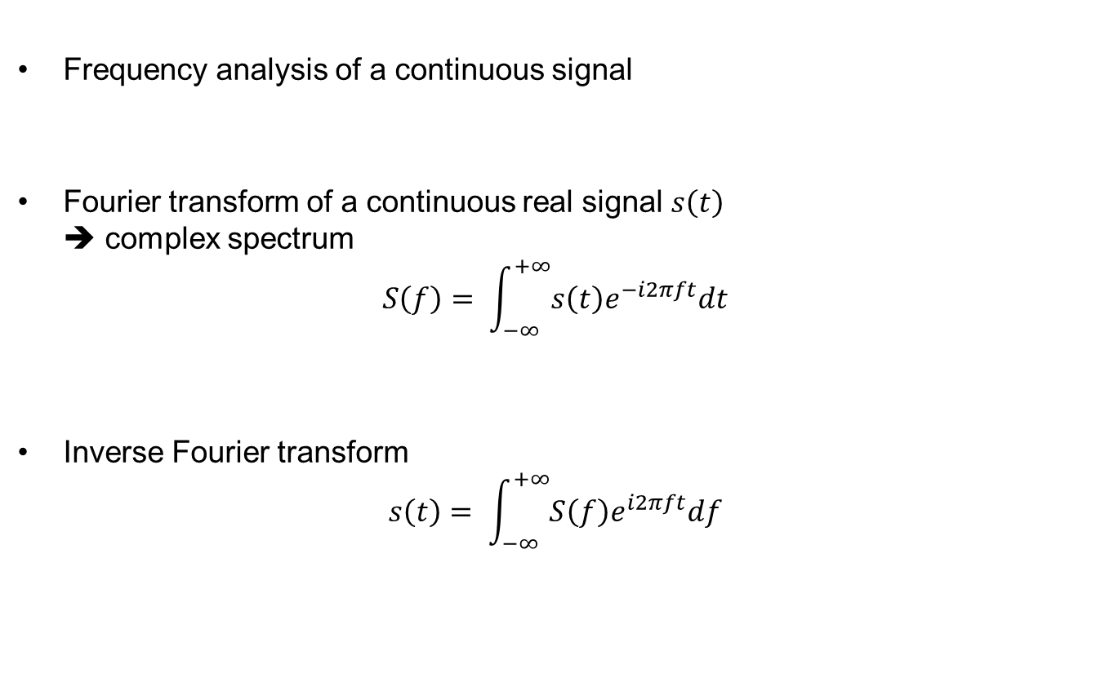
Fourier transform
Frequency analysis of a continuous signal
Fourier transform of a continuous real signal $s\left(t\right)$ ➔ complex spectrum
$$S\left(f\right)= \int_{−∞}^{+∞}{s\left(t\right)e^{−i2πft}dt}$$
Inverse Fourier transform
$$s\left(t\right)= \int_{−∞}^{+∞}{S\left(f\right)e^{i2πft}df}$$

Slide 30
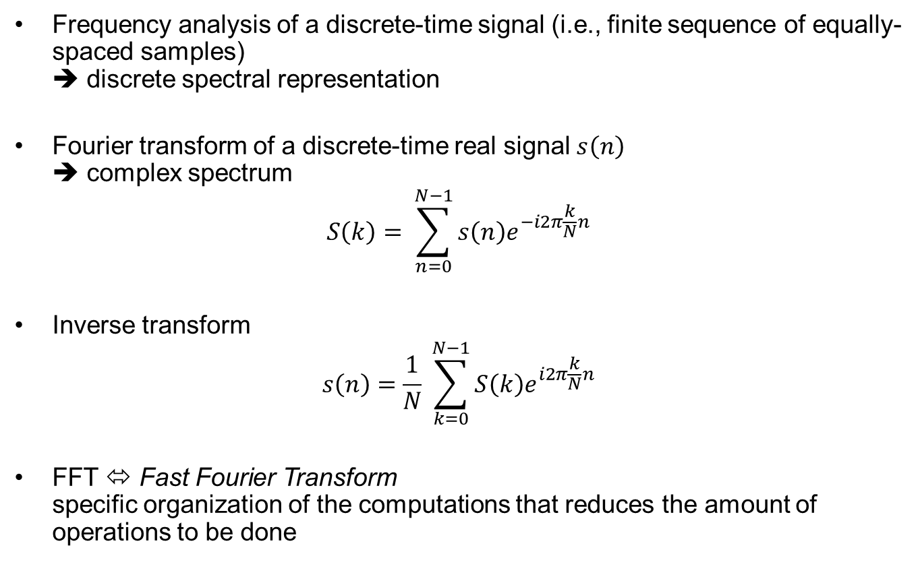
Discrete Fourier transform
Frequency analysis of a discrete-time signal (i.e., finite sequence of equally-spaced samples) ➔ discrete spectral representation
Fourier transform of a discrete-time real signal $s\left(n\right)$ ➔ complex spectrum
$$S\left(k\right)= \sum_{n=0}^{N−1}{s\left(n\right)e^{−i2π\frac{k}{N}n}}$$
Inverse transform
$$s\left(n\right)=\frac{1}{N} \sum_{k=0}^{N−1}{S\left(k\right)e^{i2π\frac{k}{N}n}}$$
FFT ⬄ Fast Fourier Transform specific organization of the computations that reduces the amount of operations to be done

Slide 31
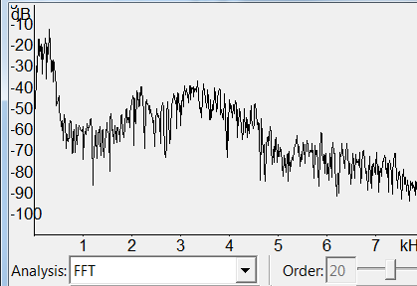
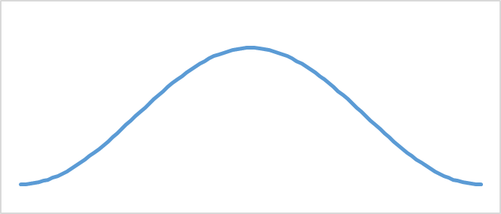
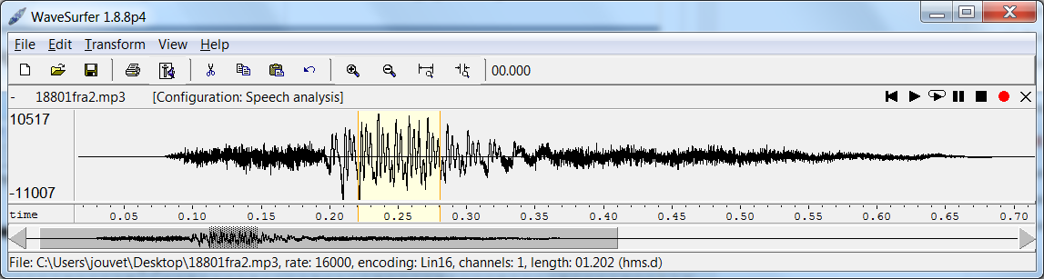
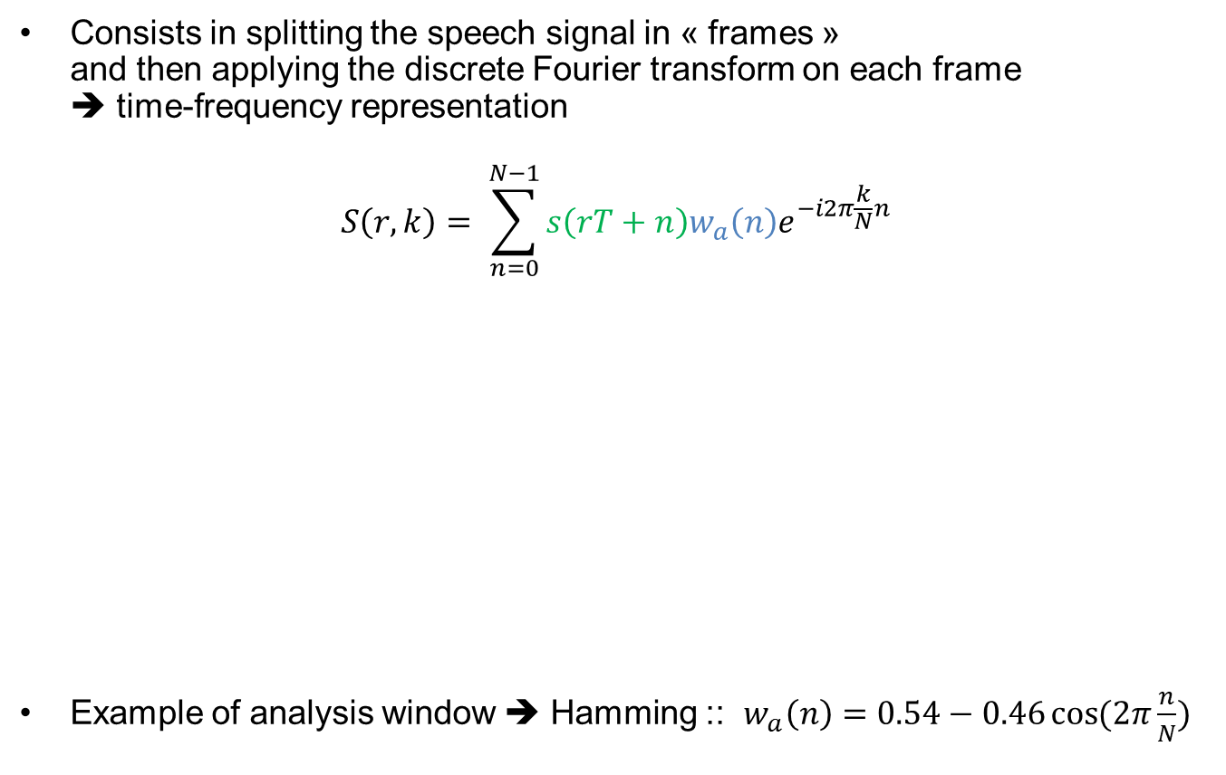
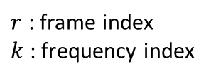
Short term Fourier transform
Consists in splitting the speech signal in « frames » and then applying the discrete Fourier transform on each frame ➔ time-frequency representation
$$S\left(r,k\right)= \sum_{n=0}^{N−1}{s\left(rT+n\right){w_{a}\left(n\right)e}^{−i2π\frac{k}{N}n}}$$
Example of analysis window ➔ Hamming :: $w_{a}\left(n\right)=0.54−0.46\cos{(2π\frac{n}{N})}$
$r$ : frame index
$k$ : frequency index
Frame
Analysis window (e.g., Hamming)

Slide 32
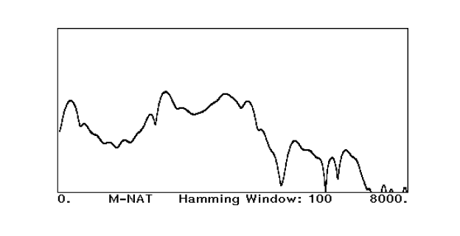
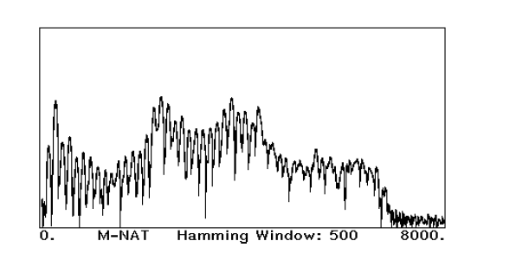
FFT size and frequency precision
Narrow window (small number of FFT points)
Good temporal precision
Bad frequency precision
Wide window (larger number of FFT points)
Good frequency precision
Bad temporal precision

Slide 33
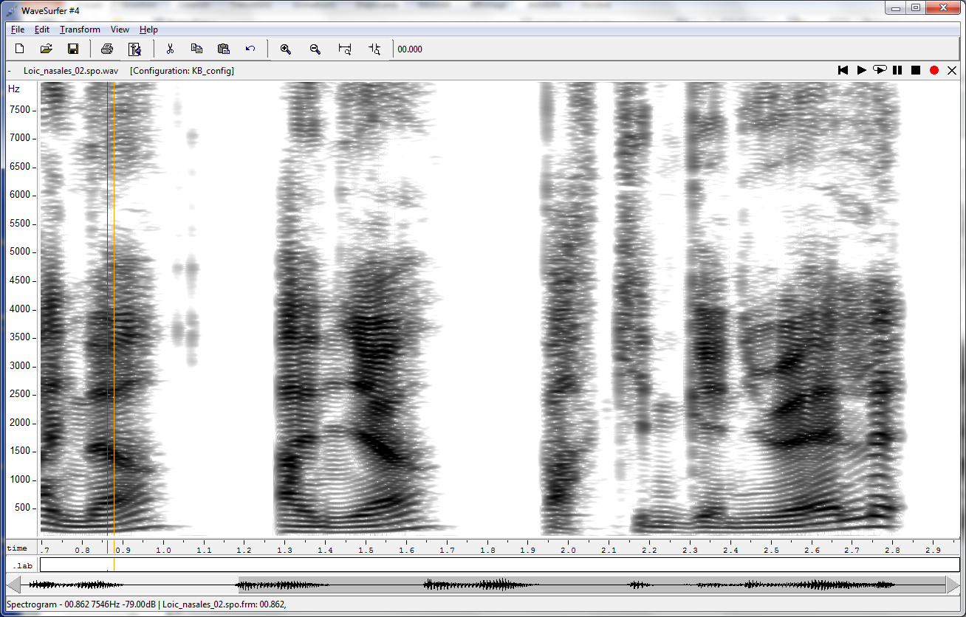
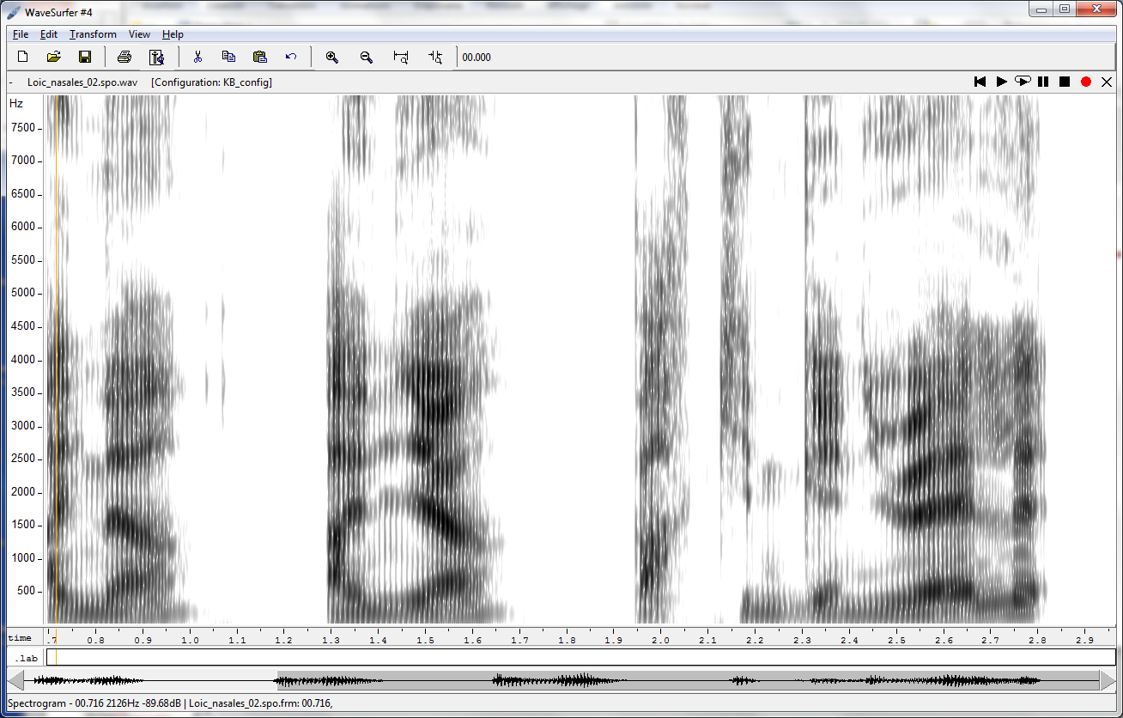
FFT size and frequency precision
Spectrogram – wide window
Spectrogram – narrow window

Slide 34
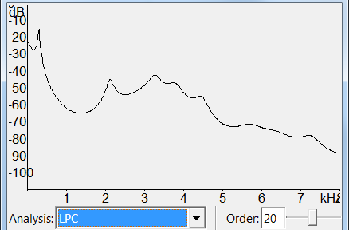
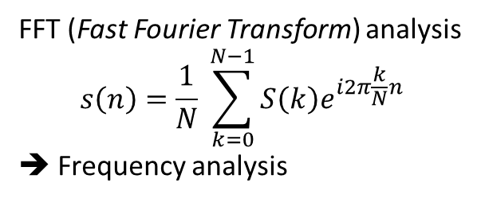
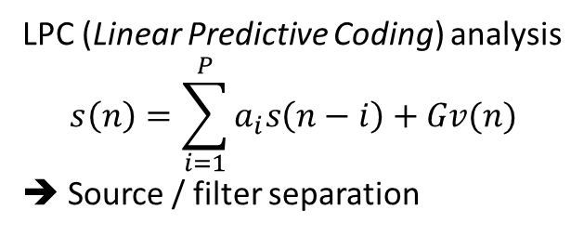
LPC analysis vs. FFT analysis
FFT (Fast Fourier Transform) analysis
$$s\left(n\right)=\frac{1}{N} \sum_{k=0}^{N−1}{S\left(k\right)e^{i2π\frac{k}{N}n}}$$
➔ Frequency analysis
LPC (Linear Predictive Coding) analysis
$$s\left(n\right)=\sum_{i=1}^{P}{a_{i}s\left(n−i\right)+Gv(n)}$$
➔ Source / filter separation

Slide 35
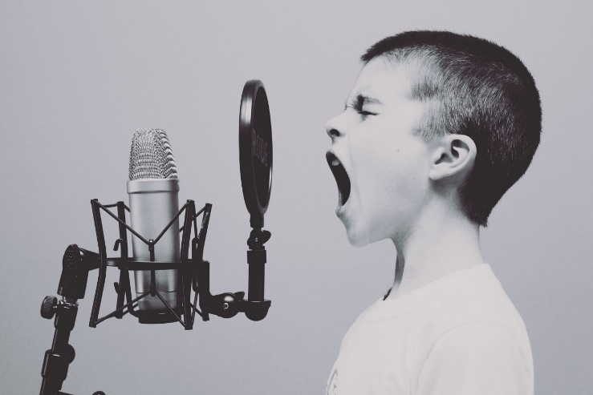
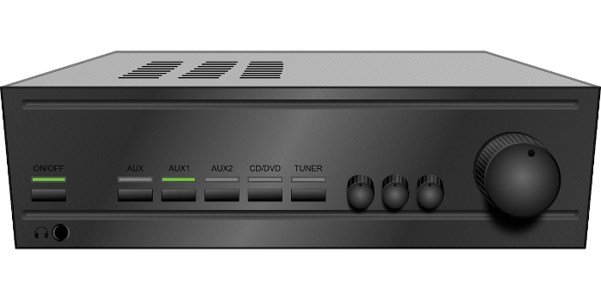
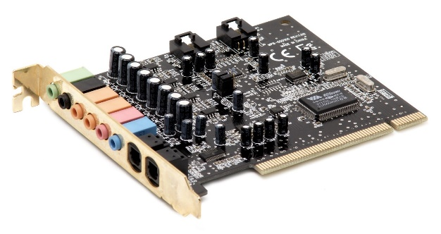
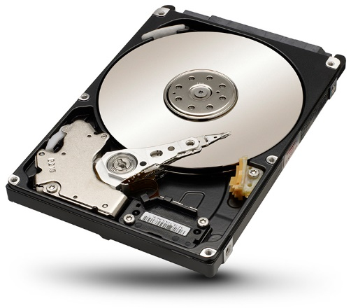
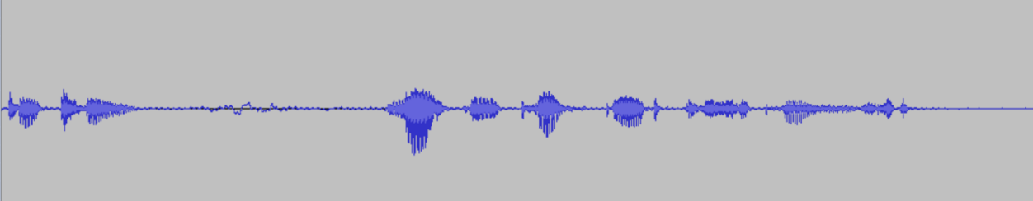
Typical recording setup

Slide 36
Analog-to-digital conversion
The analog signal – continuous variable defined for every time value – is converted in a sequence of discrete values
Analog-to-digital conversion implies
Sampling
Measures at regular time intervals
Typically => 8000 Hz, 16000 Hz, 44100 Hz
The sampling rate must be greater or equal to two times the highest frequency present in the signal (Nyquist - Shannon)
Quantization
Numerical representation of the values
For speech, typically 8 to 16 bits per sample

Slide 37
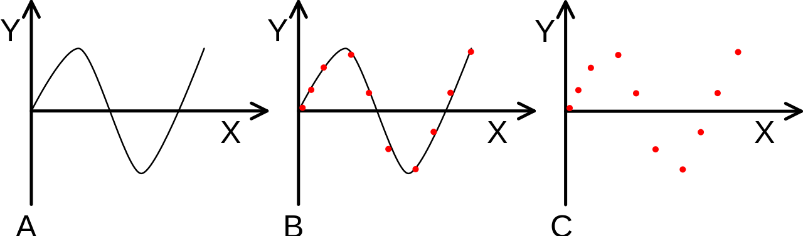
Sampling
Select samples at regular time intervals
Convert the signal to discrete time

Slide 38
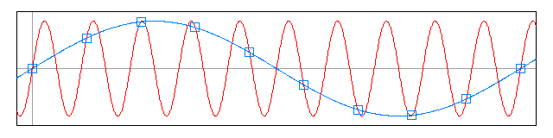

Sampling
The sampling frequency has to be at least twice larger than the frequency bandwidth of the signal (Nyquist Theorem)

Slide 39
Sampling
Impact of the sampling frequency on the signal quality:
44100 kHz (CD)
16kHz (voice)
8kHz (narrow band telephone)

Slide 40

Quantization
Use a finite number of values for the amplitude

Slide 41
Quantization (binary)
Binary digit (Bit) :
A bit can only take 2 different values: 0 or 1
n bits = coding 2^{n} different values
1 octet = 8 bits
Audio : from 16bits to 32 bits

Slide 42

Quantization error
The quantization error results from the limited precision (number of bits) available when converting a continuous value to a numerical value
Quantization error
Value
Time
Time
Samples

Slide 43


Fundamental Frequency & formants
Speech
Speech production & perception
Spectral analysis (time-frequency)
Fundamental Frequency & formants
Sounds of the language
Speech signal variability
Basics of speech recognition
Automatic speech recognition
Deep neural networks
Extracting other information
or, continue with « Basics of speech recognition »

Slide 44


Fundamental frequency
The fundamental frequency (F0) of a speech signal corresponds to the number of vibrations of the vocal cords over 1 second period
Thus, is defined only for « voiced » sounds
/i/
/a/
Fundamental frequency
Fundamental frequency

Slide 45





Computing fundamental frequency
In the temporal domain
In the spectral domain
➔7ms
➔$\frac{1}{0,007}=144 Hz$
~ $140 Hz$

Slide 46
Fundamental frequency & prosody
Prosodic parameters
Fundamental frequency (pitch)
Duration of the sounds
Energy of the sounds
Prosody used for
Structuring the spoken signal (like punctuation for written texts)
Setting emphasis on a word (or group of words)
Expressing sentence modality, i.e., question vs. affirmation
Fundamental frequency also used for
Marking the lexical stress (for example, in English)
Expressing tone in tonal languages (Chinese, Vietnamese, …)
Remark: for speech recognition, the fundamental frequency is necessary for processing tonal languages

Slide 47




Formants
Correspond to concentrations of energy at specific frequencies that results from acoustic resonances of the vocal tract
Source
Filter (vocal tract)
Periodic signal (when vocal cords vibrate)
$$F_{1}$$
$$F_{2}$$
$$F_{3}$$
$$F_{4}$$
Formants
Spectrum, phone /i/

Slide 48




Impact of bandwidth
(8000 Hz) ➔ 5 formants audible
(3000 Hz) ➔ 3 formants audible
(1800 Hz) ➔ 2 formants audible
(1000 Hz) ➔ 1 formant audible

Slide 49
Sounds of the language
Speech
Speech production & perception
Spectral analysis (time-frequency)
Fundamental Frequency & formants
Sounds of the language
Speech signal variability
Basics of speech recognition
Automatic speech recognition
Deep neural networks
Extracting other information

Slide 50
Phonemes
Phoneme : basic unit of a language’s phonology
Can be defined using minimal pair notion (minimal pair ⬄ two words that differ by a single phone)
Example :
In English: /f/ vs. /v/ in the pair « fan » / f æ n / - « van » / v æ n/
In French: /s/ vs. /d/ in the pair « six » / s i s / - « dix » / d i s /
Two main categories of phonemes
Vowels
Consonants
About 35 phonemes in French and about 44 phonemes in English

Slide 51

Vowels and consonants
Vowels ⬄ voiced sounds, realized with the mouth fairly opened, are the nucleus of spoken syllables
Consonants ⬄ sounds pronounced with a local narrowing or a local closure of the vocal tract
Spectrogram: visual representation of speech ⬄ energy at different frequencies (vertical axis) at different times (horizontal axis)

Slide 52

Production of nasal and oral vowels
Nasal articulation
Oral articulation

Slide 53


Examples of vowel articulation and spectrums
vowel /i/ vowel /a/
Formants
Formants
F₁
F₁
F₂
F₂
F₃
F₃
F₄
F₄
/i/
/a/
Fundamental frequency
Fundamental frequency
F1 ➔ 250 Hz F2 ➔ 2000 Hz F3 ➔ 3000 Hz
F1 ➔ 1400 Hz, F2 ➔ 1600 Hz F3 ➔ 3000 Hz

Slide 54


Articulation of vowels and formants
Hz
Yellow lines ⬄ Formants (F1, F2,F3)
u
i
ɑ
ɛ
ɔ
o
a
e
e
ɛ
ɑ
a
ɔ
o
u
i

Slide 55

Visualizing articulation of sounds
English sounds: http://soundsofspeech.uiowa.edu/resources/english/english.html
Spanish sounds: http://soundsofspeech.uiowa.edu/resources/spanish/spanish.html
German sounds: http://soundsofspeech.uiowa.edu/resources/german/german.html

Slide 56
French vowels acoustic and articulatory spaces
Acoustic space
F1
250
Hz
i
y
u
e
ø
o
Articulatory space
ɛ
œ
ɔ
i
u
close
mid
open
800
Hz
a
(high)
F2
3000 Hz
800 Hz
a
(low)
front
back
position of the highest point of the tongue

Slide 57
French consonants
Stop consonants: local closure (blocking the airflow), and then quick opening of the vocal tract
Unvoiced => /p/, /t/, /k/
Voiced => /b/, /d/, /g/
Fricatives : partial occlusion of the vocal tract (air flow is not blocked)
Unvoiced => /f/, /s/, /ʃ/
Voiced => /v/, /z/, /ʒ/
Liquids => /l/, /r/
Nasals => /m/, /n/, /ɲ/
Semi-vowels => /j/ as in « hier », /w/ as in « trois », /ɥ/ as in « huit »

Slide 58
French consonants
Classification with respect to the manner of articulation
Stop consonants, fricatives, nasals, liquids, semi-vowels
Voiced, unvoiced
Classification with respect to the place of articulation
bilabial => /p/, /b/, /m/
Dental => /t/, /d/, /n/, /f/, /v/
Alveolar => /s/, /z/, /l/
Palatal => /ʃ/, /ʒ/
Velar => /k/, /g/

Slide 59

Vocal tract and place of articulation

Slide 60
English phonology
List of phonemes vary depending on variants: British English vs. American English vs. Australian English …
Vowels
Also include diphtongs such as
/ɑɪ/ in try
/ɑʊ/ in hour
/ɔɪ/ in oil
Consonants
Also include affricates such as
/tʃ/ in watch
/dʒ/ in job

Slide 61
Examples of consonant spectra
/p/
stop consonant
/s/
fricative
/ʒ/
fricative
/l/
liquid
/g/
Stop consonant

Slide 62
Speech signal variability
Speech
Speech production & perception
Spectral analysis (time-frequency)
Fundamental Frequency & formants
Sounds of the language
Speech signal variability
Basics of speech recognition
Automatic speech recognition
Deep neural networks
Extracting other information

Slide 63
Variability of the speech signal
Speech detection
Speaker
Ambient noises
Sound recording
Trans- mission
Acoustic analysis
Decoding
Acoustic model
Quiet … or noisy (publics places)
Lexicon & pronunciations
Close-talk microphone
Telephone
Hands free
Language model
Gender (man / woman)
Age (child / adult)
Accent (none, regional, non-native)
Voice level (low, …, loud or even shouting)
Speaking rate (fast, …, slow, over-articulated)
Emotional state
Spontaneous speech (disfluencies: hesitations, restart, …)
Bandwidth (telephone vs. wide band)
Coding (analog vs. digital (GSM, VoIP))
Transmission quality (mobile networks, IP)

Slide 64
Allophone variants
k
a
r
ã
t
r
w
a
k
a
r
ã
t

Slide 65
Pronunciation variants
A word may have several pronunciation variants in particular, in French, with respect to the schwa /ə/ (mute-e), which may be pronounced or not
verte v e R t
verte v e R t swa
Also, in French, the word context may lead to the pronunciation of a liaison consonant (when the following word starts by a vowel)
très t R e
très t R e z
In English there are less pronunciation variants, but still variants exist, such as
soften ➔ /sɒfn/ /sɔːfn/
sorbet ➔ /sɔːbeɪ/ /sɔːrbət/

Slide 66




Different voices
Man
Woman
r e z y m e
r e z y m e
Teenager
Child
r e z y m e
r e z y m e

Slide 67


Normal vs. shouting voice
Normal voice
n ɔ̃
Shouting voice
n ɔ̃

Slide 68


Speech & noise
Environment noise
p
a
r
t
i
k
y
l
j
e
Breathing noise (before and/or
after a mot)
s
y
i
v
ã
breath

Slide 69


Basics of speech recognition
Speech
Basics of speech recognition
Automatic speech recognition
Deep neural networks
Extracting other information
or, continue with « Automatic speech recognition » : Lexicon, LMs, ….

Slide 70
Acoustic analysis
Speech
Basics of speech recognition
Acoustic analysis
Acoustic templates
Hidden Markov models
Automatic speech recognition
Deep neural networks
Extracting other information

Slide 71
Acoustic analysis
Measures on the signal, at regular time intervals (typically every 10 ms)
Speech detection
Speaker
Ambient noises
Sound recording
Trans- mission
Acoustic analysis
Decoding
Acoustic model
Training acoustic models
Lexicon & pronunciations
Speech corpus
Acoustic analysis
Estimating parameters of acoustic models
Language model
Transcription
Selecting vocabulary & word pronunciations
Text corpus
Estimating parameters of language models
Newspapers, web, ….

Slide 72
Speech signal … and spectral envelope
Speech signal
Spectral envelope of the central slice ⬄ energy at different frequencies
FFT spectrum ➔

Slide 73





Cepstrum
Lower rank cepstrum coefficients correspond to the vocal tract
Higher rank cepstrum coefficients can be use to get an estimate of the fundamental frequency
Signal:
$$s\left(t\right)=h\left(t\right)∗e(t)$$
FFT
Spectrum:
Convolution of $e(.)$ and $h(.)$
$$S\left(f\right)=H\left(f\right).E(f)$$
Product
Log(|.|)
$$log[S\left(f\right)|=\log\left|H\left(f\right)\right|+log⁡|E\left(f\right)|$$
Cepstrum: $$C=C_{h}+C_{e}$$
FFT⁻¹
Sum
Sum

Slide 74
Filter bank
Signal energy in a set of frequency bands
Characteristics of the filter banks ➔ Central frequency of the filters on a
Linear scale
Perceptive scale (Bark ou Mel)
In higher frequencies, filters are larger, and space between central frequencies gets wider
Corresponds to the frequency sensitivity of the ear (ability to distinguish small frequency differences in low frequencies)
Energy in filters can be computed from the STFT (Short Time Fourier Transform) results
Gain
0
1000
2000
3000
4000

Slide 75
Example of cepstrum analysis
Digital signal (8000 values/second for telephone speech, or 16000, or …)
Processing by blocks (25 to 32 ms time window) One frame every 10 ms
FFT spectrum ...
... logarithm of the energy for each Mel filter (~24 filters) ...
... cepstral coefficients
Inverse cosine transform
Mel filters
C1, C2, .... (10 to 13 coeff.)
Gain
0
1000
2000
3000
4000

Slide 76

Spectrogram vs. 10ms Mel spectrum French word "trois" (three)
Representation of the signal energy with respect to time (horizontal axis) and frequency (vertical axis)
Frequency
Frequency (Mel filter)
/t/
/r/
/w/
/a/
/t/
/r/
/w/
/a/
Spectrogram
Mel spectrum (frames every 10ms)

Slide 77


Pronunciation of a few French digits
0 "zéro"
/zero/
3 "trois"
/trwa/
8 "huit"
/Yit/

Slide 78


Three pronunciations of French digit "0"
Variability duration spectrum

Slide 79
Acoustic templates
Speech
Basics of speech recognition
Acoustic analysis
Acoustic templates
Hidden Markov models
Automatic speech recognition
Deep neural networks
Extracting other information

Slide 80
Decoding based on comparison to acoustic templates
Compare the acoustic form (sequence of feature vectors) of the word to recognize, to the reference acoustic templates (acoustic forms) associated to the vocabulary words. Need to take into account
Differences in durations
Variability in articulation rates
Speech detection
Speaker
Ambient noises
Sound recording
Trans- mission
Acoustic analysis
Decoding
Acoustic model
Training acoustic models
Lexicon & pronunciations
Speech corpus
Acoustic analysis
Estimating parameters of acoustic models
Language model
Transcription
Selecting vocabulary & word pronunciations
Text corpus
Estimating parameters of language models
Newspapers, web, ….

Slide 81
Comparing acoustic forms
Variability duration spectrum
Temporal alignment
"distance" between frames

Slide 82



Distortion measures between acoustic frames
L2 distance between the logarithm of two spectra
In practice, the cepstral distance is based on a finite number of terms (L)
$$d^{2}=\frac{1}{2π}\int_{−π}^{π}{{\left|\ln{f\left(ω\right)−\ln{f^{′}\left(ω\right)}}\right|}^{2}dω}$$
$$=\sum_{n=−∞}^{∞}{{\left[c\left(n\right)−c^{′}\left(n\right)\right]}^{2}}$$
$$d_{L}^{2}=\sum_{n=1}^{L}{{\left[c\left(n\right)−c^{′}\left(n\right)\right]}^{2}}$$

Slide 83

Comparison of two acoustic forms Local distances (between acoustic frames)
note: the larger the dot is, the more similar are the frames (small distance)

Slide 84
Comparison of two acoustic forms Problem of non linear temporal distortions
note: the larger the dot is, the more similar are the frames (small distance)

Slide 85

DTW : alignment and global distance
Alignment ⬄ search for the “path" that associate frames that are the most similar
➔ Dynamic programming
(DTW : Dynamic Time Warping)

Slide 86

DTW algorithm
Let define the distance $D\left(i,j\right)=\text{Dist}\left(X\left[1..i\right],Y\left[1..j\right]\right)$
Between the $i$ first frames of the test $X=\left\{X\left[i\right], i=1,…,I\right\}$
and the $j$ first frames of the reference $Y=\left\{Y\left[j\right], j=1,…,J\right\}$
For $i=1,…,I$ (test frames)
For $j=1,…,J$ (reference frames)
$D\left(i,j\right)=\min\left\{\begin{matrix}D(i−1,j) \\ D(i−1,j−1) \\ D(i−1,j−2)\end{matrix}\right\}+d\left(X\left[i\right],Y\left[j\right]\right)$
End for
End for
$D\left(I,J\right)$ is the global distance
$d\left(X | i\right],Y[j])$ is the local distance between frames $X[i]$ et $Y[j]$
X[i-1]
X[i]
Insertion of a frame
Y[j]
Normal progression
Reference
Y[j-1]
Deletion of a frame
Y[j-2]
Test

Slide 87

Comparison of “0” with “0”
X[i-1]
X[i]
Y[j]
Reference
Y[j-1]
Y[j-2]
Test

Slide 88

Comparison of “6” with “0”
X[i-1]
X[i]
Y[j]
Reference
Y[j-1]
Y[j-2]
Test

Slide 89
Hidden Markov models
Speech
Basics of speech recognition
Acoustic analysis
Acoustic templates
Hidden Markov models
Automatic speech recognition
Deep neural networks
Extracting other information

Slide 90
Hidden Markov models
Statistical representation of the acoustic realizations of a sound or of a word
Definition of a hidden Markov model (HMM)
Decoding with HMMs
Estimating HMM parameters
Speech detection
Speaker
Ambient noises
Sound recording
Trans- mission
Acoustic analysis
Decoding
Acoustic model
Training acoustic models
Lexicon & pronunciations
Speech corpus
Analyse acoustique
Estimating parameters of acoustic models
Language model
Transcription
Selecting vocabulary & word pronunciations
Text corpus
Estimating parameters of language models
Newspapers, web, ….

Slide 91












Hidden Markov model (HMM)
$$a_{i−1,i−1}$$
$$a_{i,i}$$
$$a_{i+1,i+1}$$
Transitions
$$a_{i−1,i}$$
$$a_{i,i+1}$$
States
…
…
Probability density functions (pdf)
$$b_{i−1}(.)$$
$$b_{i}(.)$$
$$b_{i+1}(.)$$
$$\text{P}\left(x_{t} | q_{i}\right)=b_{i}\left(x_{t}\right) \\ =\sum_{k=1..K}{c_{i,k}G_{i,k}(x_{t})}$$
Parameters :
Trans. proba. $a_{i,j}$
Observation (acoustic vector)
Gauss. comp. weight $c_{i,k}$
…
Gauss. param. $μ_{i,k} \& Σ_{i,k}$
Gaussian components

Slide 92









Hidden Markov model - parameters
$$a_{i−1,i−1}$$
$$a_{i,i}$$
$$a_{i+1,i+1}$$
HMMs are defined by two main components
Underlying Markov chain ⬄ finite automaton + probabilities
Initial probabilities $π_{i}=\text{P}\left(q_{1}=i\right)$, such that $\sum_{i=1}^{N}{π_{i}}=1$
Transition probabilities $a_{ij}=\text{P}(q_{t+1}=j|q_{t}=i)$ such that $\sum_{j=1}^{N}{a_{ij}=1}$
Set of probability density functions (pdf) (typically Gaussian mixture models - GMM)
pdf $b_{i}\left(x_{t}\right)=\text{P}\left(x_{t} | q_{t}=i\right)$ where $b_{i}\left(x_{t}\right)=\sum_{k=1}^{K}{c_{i,k}G_{i,k}(x_{t};μ_{i,k},Σ_{i,k})}$ $=\sum_{k=1}^{K}{c_{i,k}\frac{1}{{\left(2π\right)}^{D/2}{\left|Σ_{i,k}\right|}^{1/2}}\exp{(−\frac{1}{2}{\left(x_{t}−μ_{i,k}\right)}^{T}Σ_{i,k}^{−1}(x_{t}−μ_{i,k}))}}$ with $\sum_{k=1}^{K}{c_{i,k}=1}$
Transitions
$$a_{i−1,i}$$
$$a_{i,i+1}$$
States
…
…
Probability density functions
$$b_{i−1}(.)$$
$$b_{i}(.)$$
$$b_{i+1}(.)$$

Slide 93
Hidden Markov models three main problems
How to compute the likelihood of an observation (for the speech recognition step)
Given an observation, how to determine the state sequence which best explains the observation (for the speech recognition and for the training steps) ⬄ Viterbi algorithm
Given a set of observations, how to determine the model parameters to best fit these observations (training)
note: observation ⬄ acoustic form ⬄ sequence of acoustic frame vectors

Slide 94

Computing the likelihood of an observation
Compute
$$\text{P}\left(X | Λ\right)=\sum_{state sequences Q}{P(X,Q|Λ)}=\sum_{q_{1},q_{2},…,q_{T}}{P(x_{1}, x_{2}, …x_{T},q_{1},q_{2},…,q_{T}|Λ)}$$
Iterative approach « forward »
$$α_{t+1}\left(j\right)=\sum_{q_{1},q_{2},…,q_{t−1},q_{t}}{P(x_{1},x_{2},…,x_{t+1},q_{1},q_{2},…,q_{t+1}=j|Λ)}$$
conditional probabilities ➔
$P(x_{1},x_{2},…,x_{t},x_{t+1},q_{1},q_{2},…, q_{t},q_{t+1}=j|Λ)$
$=P\left(x_{1},x_{2},…,x_{t},q_{1},q_{2},…,q_{t} | Λ\right)$
$P\left(q_{t+1}=j|x_{1},x_{2},…,x_{t},q_{1},q_{2},…,q_{t},Λ\right)$
$P\left({x_{t+1}|x_{1},x_{2},…,x_{t},q_{1},q_{2},…,q_{t},q}_{t+1}=j,Λ\right)$
$=P\left(x_{1},x_{2},…,x_{t},q_{1},q_{2},…,q_{t} | Λ\right)$
$P\left(q_{t+1}=j|q_{t},Λ\right)$
$P\left({x_{t+1}|q}_{t+1}=j,Λ\right)$
Hence
$$α_{t+1}\left(j\right)=\sum_{i}{α_{t}\left(i\right)}P\left(q_{t+1}=j|q_{t}=i,Λ\right)b_{j}\left(x_{t+1}\right)=\sum_{i}{α_{t}\left(i\right)}a_{i,j}b_{j}(x_{t+1})$$

Slide 95










Computing the likelihood of an observation
Iterative approach « forward » $α_{t+1}\left(j\right)=P\left(x_{1},…,x_{t+1};q_{t+1}=q_{j} | Λ\right)$ $=\sum_{i}{α_{t}\left(i\right)a_{i,j}b_{j}(x_{t+1})}$
Initialisation step $α_{1}\left(j\right)=π_{j}b_{j}\left(x_{1}\right)$
Observation probability is then given by
$$P\left(X | Λ\right)=\sum_{j}{α_{T}(j)}$$
Iterative approach « backward » similar, but backward with respect to time $t=T, T−1, T−2, …, 1$ using variable $β_{t}\left(i\right)=P(x_{t+1}, x_{t+2},…,x_{T}|q_{t}=q_{i},Λ)$
$$j$$
$$α_{t}\left(j\right)$$
$$α_{t+1}\left(j\right)$$
$$α_{t}\left(j−1\right)$$
$$j−1$$
$$α_{t}\left(j−2\right)$$
$$j−2$$
$$t$$
$$t+1$$

Slide 96

Viterbi decoding
Similar to the iterative approach « forward », but consider only the “best” state sequence
$$\max_{Q}{P\left(X,Q | Λ\right)=\max_{q_{1},…,q_{T}}{P(x_{1},…,x_{T};q_{1},…,q_{T}|Λ)}}$$
Iterations for Viterbi decoding $δ_{t+1}\left(j\right)=\max_{q_{1},…,q_{t}}{P(x_{1},…,x_{t+1};q_{1},…,q_{t},q_{t+1}=j|Λ)}$ $=\max_{i}{δ_{t}\left(i\right)a_{i,j}b_{j}(x_{t+1})}$
Viterbi decoding is the algorithm used for speech recognition ➔ the words associated to the best path provide the speech recognition results

Slide 97







Viterbi decoding
$$δ_{t+1}\left(j\right)=\max_{i}{δ_{t}\left(i\right)a_{ij}b_{j}(x_{t+1})}$$
$$δ_{t}\left(j\right)$$
$$δ_{t+1}\left(j\right)$$
$$δ_{t}\left(j−1\right)$$
$$δ_{t}\left(j−2\right)$$

Slide 98
Acoustic form ⬄ hidden Markov model
Variability duration spectrum
Alignment frames <-> states
Probabilities with respect to pdf

Slide 99

Training ⬄ Optimization of model parameters
Determine the parameters of the model $Λ$ in order to maximize the likelihood of the training data $X^{∗}=\{X^{1},X^{2},…,X^{R}\}$
$$Λ^{opt}=\underset{Λ}{argmax}{P(X^{∗}|Λ)}=\underset{Λ}{argmax}{\prod_{r}{P(X^{r}|Λ)}}$$
Iterative approach
Initialization
Average value identical for all the pdf or more specific values using segmented and annotated speech data
Iterations – EM approach (Expectation-Maximization)
Estimation step (expectation) ➔ Estimate the probability of usage of the states, transitions, and Gaussian components when the model is used to generate the training data
Maximisation step ➔ Determine from the above estimates, new values of the model parameters (that increase the likelihood of the training data)
Stopping criterion
Convergence or maximum number of iterations

Slide 100


Optimization of model parameters transition probabilities
$$a_{ij}=\text{P}(q_{t+1}=j|q_{t}=i)$$
Iterative procedure – at each iteration
The new value of the transition probability from state $i$ to state $j$ is given by
$${\hat{a}}_{i,j}=\frac{\sum_{r}{\sum_{t}{P\left({q_{t}=i,q}_{t+1}=j | X^{r},Λ\right)}}}{\sum_{r}{\sum_{t}{P\left(q_{t}=i | X^{r},Λ\right)}}}=\frac{\sum_{r}{\sum_{t}{ζ_{t}^{r}(i,j) }}}{\sum_{r}{\sum_{t}{\sum_{j}{ζ_{t}^{r}(i,j)}}}}$$
where $ζ_{t}^{n}\left(i,j\right)$ is the probability of usage of the transition for moving from state $i$ at time $t$, to state $j$ at time $t+1$ (for the observation $X^{r}$)
$$ζ_{t}^{r}\left(i,j\right)= P\left(q_{t}=i,q_{t+1}=j | X^{r},Λ\right)= \frac{α_{t}^{r}\left(i\right){ a_{ij} b_{j}\left(x^{t+1}\right) β}_{t+1}^{r}\left(j\right)}{P\left(X^{r} | Λ\right)}$$
Typically a few iterations (from 5 to 20 iterations)
( This algorithm is also known as Baum-Welch algorithm )
Forward
Backward

Slide 101





Optimization of model parameters
$$j$$
$$α_{t}^{r}(i)$$
$$β_{t+1}^{r}(j)$$
$$i$$
observation $X^{r}$

Slide 102



Optimization of model parameters mean vectors of Gaussian components
Iterative procedure – at each iteration
The new value of the mean vector of the $k$^{th} Gaussian component of the pdf associated to state $i$ is given by
$${\hat{μ}}_{i,k}=\frac{\sum_{r}{\sum_{t}{P\left({q_{t}=i,m}_{t}=k | X^{r},Λ\right){ x}_{t}^{r}}}}{\sum_{r}{\sum_{t}{P\left({q_{t}=i,m}_{t}=k | X^{r},Λ\right)}}}=\frac{\sum_{r}{\sum_{t}{γ_{t}^{r}(i,k){ x}_{t}^{r}}}}{\sum_{r}{\sum_{t}{γ_{t}^{r}(i,k)}}}$$
where $γ_{t}^{r}\left(i,k\right)$ is the probability of usage of the $k$^{th} Gaussian component of the pdf associated to state $i$ at time $t$ (for the observation $X^{r}$)
$$γ_{t}^{r}\left(i,k\right)= P\left(q_{t}=i,m_{t}=k | X^{r},Λ\right)= \frac{α_{t}^{r}\left(i\right){ β}_{t}^{r}\left(i\right)}{P\left(X^{r} | Λ\right)} \frac{c_{ik}G(x_{t}|μ_{ik},Σ_{ik})}{\sum_{l}{c_{il}G(x_{t}|μ_{il},Σ_{il})}}$$
Typically a few iterations (from 5 to 20 iterations)
(This algorithm is also known as Baum-Welch algorithm )
Forward
Backward
Probability to be in state $i$ at time $t$
Contribution of the $k$^{th} component to the pdf probability

Slide 103






Example of training iterations model of French digit « 0 » - « flat initialization »
Initialization
Iteration 1
Iteration 2

Slide 104
Remarks on the training process
Baum-Welch algorithm (i.e. above formula)
Takes into account all possible paths (state sequences)
Needs to take care of numerical problems (sums of probabilities) ➔ Computations (forward and backward variables) need to be normalized
Viterbi algorithm
Handles only the information corresponding to the best matching path
Computations using logarithm of probabilities avoid numerical problems
Both approaches converge toward a local extremum
The trained model corresponds to the observations (speech data) of the training set. For optimal performance, the training set must match the foreseen usage conditions: speaker, environment, …
Nevertheless, the choice of the topology (number of states, transitions, …) is to be done a priori

Slide 105



Examples of models for the French digit "0"
8 states model
16 states model
32 states model

Slide 106


Automatic speech recognition
Speech
Basics of speech recognition
Automatic speech recognition
Deep neural networks
Extracting other information
or, back to « Speech » : F0, phones, variability, ….

Slide 107
Lexicons and language models
Speech
Basics of speech recognition
Automatic speech recognition
Lexicons and language models
Continuous speech recognition
Speech signal variability
Measures of performance
Robustness & adaptation
Performance improvements
Deep neural networks
Extracting other information

Slide 108
Models of phones and pronunciation variants
Representation of the possible pronunciations of the words
Contextual modeling of the phones
Pronunciation variants
Speech detection
Speaker
Ambient noises
Sound recording
Trans- mission
Acoustic analysis
Decofing
Acoustic model
Training acoustic models
Lexicon & pronunciations
Speech corpus
Acoustic analysis
Estimating parameters of acoustic models
Language model
Transcription
Selecting vocabulary & word pronunciations
Text corpus
Estimating parameters of language models
Newspapers, web, ….

Slide 109
Allophonic variants
k
a
r
ã
t
r
w
a
k
a
r
ã
t

Slide 110

Modeling based on phonemes vs. words
Word-based
zero
Robust for isolated words, but requires many examples of the words for training
Phoneme-based
z
e
r
o
Reduce number of units, language dependent but modeling of contextual influence is not properly handled
Context-dependent phonemes
[?] z [e]
[z] e [r]
[e] r [o]
[r] o [?]
Number of possible units is very large ($N=40$ phonemes => $N^{3}≈$ 64,000 triphones), allows to model any word by concatenating the relevant models, but problem for estimating some parameters ➔ sharing of parameters

Slide 111
Modeling with context-dependent phonemes handling word boundary contexts
Example: possible pronunciations for French number "35"
Modelling with context-independent phonemes
ə
#
ə
t
r
ã
t
s
ɛ̃
k
Modeling with context-dependent phonemes (called triphones)
[ã] t [#]
#
[#] s [ɛ̃]
[t] ə [#]
[ɛ̃] k [ə]
[k] ə [#]
[#] t [r]
[t] r [ã]
[r] ã [t]
[ã] t [ə]
[s] ɛ̃ [k]
[t] ə [s]
[ə] s [ɛ̃]
[ɛ̃] k [#]
[ã] t [s]
[t] s [ɛ̃]

Slide 112
Sharing of pdfs for context-dependent phoneme modeling
pdf specific to each state
pdfs shared between states
Model for [p] a [r]
Model for [p] a [r]
Model for [b] a [d]
Model for [b] a [d]
Sharing is determined automatically using decision tree

Slide 113
Sharing of pdfs for context-dependent phoneme modeling
Sharing determined automatically using decision trees
Approach
Train a context-dependent phoneme model with single Gaussian pdfs ➔ 1 pdf (only one Gaussian component) for each state
Prepare a set of « questions », each question corresponds to a class of phonemes, such as: « is-it a vowel? », « is-it a consonant? », « is-it a fricative? », …, « is it a voiced fricative? », ….
Decision trees are built through an iterative process that select for each node the question that leads to the best score (i.e., highest probability for the resulting pair of data subsets)
Then, arbitrary choice of the total number of shared pdfs

Slide 114
Example of decision tree
In practice, the resulting decision trees are much deeper than on this example

Slide 115
Lexicon – pronunciation variants
Associate to each word of the lexicon, the possible pronunciation variants, e.g.:
très t R e vertes v e R t
très(2) t R e z vertes(2) v e R t swa
verte v e R t vertes(3) v e R t z
verte(2) v e R t swa vertes(4) v e R t swa z
In French, the largest amount of pronunciation variants corresponds to
To the pronunciation, or not, of the schwa /ə/ at the end of the word
To the pronunciation of a liaison consonant, after some words, when the next one starts by a vowels
Examples in English (from cmudict)
soften S AA F AH N sorbet S AO R B EY
soften(2) S AO F AH N sorbet(2) S AO R B EH T

Slide 116
Pronunciation variants
How to obtain the pronunciations variants of the words?
From pronunciation lexicons (when available)
Through the use of graphemes-to-phonemes converters
Rules (defined manually)
Automatic approaches
Joint Multigram Models,
Conditional Random Fields,
Neural networks, …
trained from data (large set of examples < word ⬄ pronunciations >)

Slide 117
Lexicons
The lexicon is critical
The lexicon specifies the list of words known by the ASR system
An ASR system cannot recognized words that are not in the lexicon (words not in the lexicon are also called “out-of-vocabulary words”)
It is impossible to have a lexicon covering all possible words (because of person names, company names, product names, …)
Diachronic evolution of vocabularies (e.g., due to new topics in the news that refer to new persons, new locations, …)
The lexicon also specifies the possible pronunciations of the words
Must include the usual pronunciation variants
But one should not include too many useless variants as this increases possible confusions between vocabulary words (because of that, the recognition of non-native speech is still a problem)

Slide 118
Language models
Representation of the possible sequences of words
Modeling
Usage in speech decoding
Speech detection
Speaker
Ambient noises
Sound recording
Trans- mission
Acoustic analysis
Decoding
Acoustic model
Training acoustic models
Lexicon & pronunciations
Speech corpus
Acoustic analysis
Estimating parameters of acoustic models
Language model
Transcription
Selecting vocabulary & word pronunciations
Text corpus
Estimating parameters of language models
Newspapers, web, ….

Slide 119
Language models
Provide information on the possible sequences of words
Context-free grammars
Specify sequences of words corresponding to « sentences » (i.e. global constraints)
n-gram statistical model
Provide local constraints (on sequences of n words)
Estimation from text corpora
Neural network models
Many different approaches proposed in the literature

Slide 120
Context-free grammars
Rules (or graphs) that describe exactly the allowed sentences (sequences of words) of the language (e.g., isolated digits, numbers, …)
Ex. Number_from_20_to_69
Number_from_20_to_69 = Tens_from_20_to_60 | Tens_from_20_to_60 . Units_from_1_to_9 ; Tens_from_20_to_60 = 20 | 30 | 40 | 50 | 60 ; Units_from_1_to_9 = 1 | 2 | 3 | 4 | 5 | 6 | 7 | 8 | 9 ;
Global constraints on the sentences
Complex and difficult to define for large vocabularies
Do not allow the recognition of sentences that do not respect the grammar
20
1
2
30
3
40
4
5
50
6
7
60
8
9

Slide 121
Example of grammar
Grammar JSGF – digit loop
#JSGF V1.0
grammar digits;
public <digitloop> = <digit> + ;
<digit> = zero | one | two | three | four | five | six | seven | eight | nine | oh ;
Excerpt FSG
FSG_BEGIN <digits.digitloop>
NUM_STATES 3
START_STATE 0
FINAL_STATE 1
TRANSITION 0 1 1.000000 zero
TRANSITION 0 1 1.000000 one
……
TRANSITION 0 1 1.000000 oh
TRANSITION 0 2 1.000000 zero
……
TRANSITION 0 2 1.000000 nine
TRANSITION 0 2 1.000000 oh
TRANSITION 2 0 1.000000
FSG_END
zero
one
0
…
1
oh
oh
nine
…
zero
2

Slide 122

N-gram language model
Statistical model
Probability of a word sequence $P\left(w_{1},…,w_{N}\right)=P\left(w_{1}\right)\prod_{i=2..N}{P(w_{i}|w_{1},…,w_{i−1})}$
N-gram approximation, as n-grams deal with sequences of $n$ words $P\left(w_{i} | w_{1}, …,w_{i−1}\right)≜P\left(w_{i} | w_{i−(n−1)}, …,w_{i−1}\right)$
N-gram parameters are computed from large text corpora

Slide 123

Examples of n-grams
Sentence : the sky is blue
➔ <s> the sky is blue </s> including start and end of sentence symbols
Unigrams
P(Sentence) = P(the) . P(sky) . P(is) . P(blue)
$$P\left(Sentence\right)=\prod_{i}{P\left(w_{i}\right) } P\left(w_{i}\right)=\frac{count(w_{i})}{\sum_{j}{count(w_{j})}} P\left(′est′\right)=\frac{count(′is′)}{\sum_{j}{count(w_{j})}}$$
Bigrams
P(Sentence) = P(the|<s>) . P(sky|the) . P(is|sky) . P(blue|is) . P(</s>|blue)
$$P\left(Sentence\right)=P(w_{1}|<s>)\prod_{i=2,..N}{P(w_{i}|w_{i−1})}$$
$$P\left(w_{i}|w_{i−1}\right)=\frac{count({w_{i−1}w}_{i})}{\sum_{j}{count({w_{i−1}w}_{j})}} P\left(′is′|^{′}sky′\right)=\frac{count(′sky^{′} ′is′)}{\sum_{j}{count({′sky′ w}_{j})}}$$
Trigrams
P(Sentence) = P(the|<s>) . P(sky|<s> the) . P(is|the sky) . P(blue|sky is) . P(</s>|is blue)
Counts on text training corpus

Slide 124

n-gram language model – bigrams
Bigrams ⬄ sequences of 2 words ➔ $P(w_{i}|w_{i−1})$
Estimation $P\left(w_{i} | w_{i−1}\right)=\frac{N(w_{i−1},w_{i})}{N(w_{i−1})}$ if $N(w_{i−1})$ non zero
N-gram provide local constraints (bigrams ⬄ sequences of 2 words)
When the speaker does not follow the expected syntax, speech recognition errors are usually limited to a few words
For a 1,000 word vocabulary, there 1,000,000 possible 2-word sequences!
It is impossible to estimate exactly all the parameters, so “smoothing” techniques are used (classes of words, backoff, ...)

Slide 125

N-gram language model – backoff
Backoff -- used to approximate the probability of a sequence of words, when the corresponding sequence is not present in the training data
Typically $P\left(w_{i}\right|w_{i−2},w_{i−1})= \frac{N(w_{i−2},w_{i−1},w_{i})}{N(w_{i−2},w_{i−1})}$
What is the probability, if event unseen, i.e., if $N\left(w_{i−2},w_{i−1},w_{i}\right)=0$ ?
One possible approach: « discounting » $P\left(w_{i}\right|w_{i−2},w_{i−1})=\left\{\begin{matrix}\frac{N\left(w_{i−2},w_{i−1},w_{i}\right)−d }{N(w_{i−2},w_{i−1})} if N\left(w_{i−2},w_{i−1},w_{i}\right)>0 \\ α\left(w_{i−2},w_{i−1}\right).\frac{N\left(w_{i−1},w_{i}\right)}{N\left(w_{i−1} \right)} else \end{matrix}\right.$ where $d$ is a fixed value (typically of the order of 0.5) and $α(w_{i−2},w_{i−1})$ is used to normalize probabilities ($\sum_{w_{i}}{P\left(w_{i}\right|w_{i−2},w_{i−1})=1}$)
Note: one should also take into account the case $N\left(w_{i−1},w_{i}\right)=0$

Slide 126

Evaluating a language model
Perplexity
$$ppl=\sqrt[M]{\frac{1}{P(w_{1},…,w_{i}, …,w_{M})}}=\sqrt[M]{\frac{1}{\prod_{i}{P(w_{i}|h_{i})}}}=2^{−\frac{1}{M}\sum_{i}{\log_{2}P(w_{i}|h_{i})}}$$ where $M$ is the total number of words (in the sentence or in the corpus) and $h_{i}$ is the history (i.e., preceding words) of the word $w_{i}$ Note that $ppl=2^{cross_entropie}$
Remark, one can rewrite the formula $\prod_{i}{P(w_{i}|h_{i})}={\left(\frac{1}{ppl}\right)}^{M}$
However, for a vocabulary of N equiprobable words, $P\left(w_{i}|h_{i}\right)=1/N$; hence $\prod_{i}{P(w_{i}|h_{i})}={\left(\frac{1}{N}\right)}^{M}={\left(\frac{1}{ppl}\right)}^{M}$
➔ The perplexity corresponds to the average branching factor The lower the perplexity is, the better is the quality of the language model

Slide 127
Continuous speech recognition
Speech
Basics of speech recognition
Automatic speech recognition
Lexicons and language models
Continuous speech recognition
Speech signal variability
Measures of performance
Robustness & adaptation
Performance improvements
Deep neural networks
Extracting other information

Slide 128

Decoding
Reminder : optimal decoding results given by
$$\hat{W}=\underset{W}{argmax}{\text{P}\left(W | X\right)} \\ =\underset{W}{argmax}{\frac{\text{P}\left(X | W\right)P(W)}{P(X)}}$$
$$=\underset{W}{argmax}{\text{P}\left(X | W\right)P(W)}$$
Acoustic model & pronunciation variants
Syntax
⬄ Language model

Slide 129




Hidden Markov model - parameters
$$a_{i−1,i−1}$$
$$a_{i,i}$$
$$a_{i+1,i+1}$$
HMM are defined by two main components
Underlying Markov chain ⬄ finite automaton + probabilities
Initial probabilities $π_{i}=\text{P}\left(q_{1}=i\right)$, such that $\sum_{i=1}^{N}{π_{i}}=1$
Transition probabilities $a_{ij}=\text{P}(q_{t+1}=j|q_{t}=i)$ such that $\sum_{j=1}^{N}{a_{ij}=1}$
Set of probability density functions (pdf) (typically Gaussian mixture models - GMM)
pdf $b_{i}\left(x_{t}\right)=\text{P}\left(x_{t} | q_{t}=i\right)$ where $b_{i}\left(x_{t}\right)=\sum_{k=1}^{K}{c_{i,k}G_{i,k}(x_{t};μ_{i,k},Σ_{i,k})}$ with $\sum_{k=1}^{K}{c_{i,k}=1}$
Transitions
$$a_{i−1,i}$$
$$a_{i,i+1}$$
States
…
$$q_{i−1}$$
$$q_{i}$$
$$q_{i+1}$$
…
Probability density functions
$$b_{i−1}(.)$$
$$b_{i}(.)$$
$$b_{i+1}(.)$$

Slide 130

Viterbi decoding
Iterative approach which consider only the “best” state sequence
$$\max_{Q}{P\left(X,Q | Λ\right)=\max_{q_{1},…,q_{T}}{P(x_{1},…,x_{T};q_{1},…,q_{T}|Λ)}}$$
Iterations for Viterbi decoding $δ_{t+1}\left(j\right)=\max_{q_{1},…,q_{t}}{P(x_{1},…,x_{t+1};q_{1},…,q_{t},q_{t+1}=j|Λ)}$ $=\max_{i}{δ_{t}\left(i\right)a_{i,j}b_{j}(x_{t+1})}$
Viterbi decoding is the algorithm used for speech recognition ➔ the words associated to the best path provide the speech recognition results

Slide 131







Viterbi decoding
Iterative approach $δ_{t+1}\left(j\right)=\max_{q_{1},…,q_{t}}{P(x_{1},…,x_{t+1};q_{1},…,q_{t},q_{t+1}=j|Λ)}$
➔
$$δ_{t+1}\left(j\right) =\max_{i}{δ_{t}\left(i\right)a_{i,j}b_{j}(x_{t+1})}$$
Initialization $δ_{1}\left(1\right)=π_{1}b_{1}\left(x_{1}\right)$
$$δ_{1}\left(j\right)=0 ∀ j≠1$$
Observation probability is given by
$$P\left(X | Λ\right)=δ_{T}(J)$$
where $J$ is the final state
$$j$$
$$δ_{t}\left(j\right)$$
$$δ_{t+1}\left(j\right)$$
$$δ_{t}\left(j−1\right)$$
$$j−1$$
$$δ_{t}\left(j−2\right)$$
$$j−2$$
$$t$$
$$t+1$$

Slide 132
Viterbi decoding
$$δ_{t+1}\left(j\right)=\max_{i}{δ_{t}\left(i\right)a_{ij}b_{j}(x_{t+1})}$$
$$δ_{t}\left(j\right)$$
$$δ_{t+1}\left(j\right)$$
$$δ_{t}\left(j−1\right)$$
$$δ_{t}\left(j−2\right)$$

Slide 133







Viterbi decoding & word sequences first case: without language model
Word $W_{n}$
Score of the initial state of word $w_{n}$ at time $t+1$
HMM loop on initial state
$$δ_{t+1}\left(w_{n},I\right)=\max\left\{\begin{matrix}δ_{t}\left(w_{n},I\right) a_{I,I} b_{I}^{n}(x_{t+1}) \\ \\ \max_{w_{k}}\left\{δ_{t}(w_{k},q_{F}^{k})\right\} b_{I}^{n}(x_{t+1})\end{matrix}\right.$$
Word $W_{2}$
Best ending word score (final state $q_{F}^{k}$ of word
$w_{k}$) at time $t$
Word $W_{1}$
Emission probability of frame $x_{t+1}$
t
t+1

Slide 134



Viterbi decoding & word sequences first case: with language model
Word $W_{n}$
Score of the initial state of word $w_{n}$ at time $t+1$
HMM loop on initial state
$$δ_{t+1}\left(w_{n},I\right)=\max\left\{\begin{matrix}δ_{t}\left(w_{n},I\right) a_{I,I} b_{I}^{n}(x_{t+1}) \\ \\ \max_{w_{k}}\left\{δ_{t}\left(w_{k},q_{F}^{k}\right) P(w_{n}|w_{k})\right\} b_{I}^{n}(x_{t+1})\end{matrix}\right.$$
Word $W_{2}$
Best score (word score & language model)
Word $W_{1}$
Emission probability of frame $x_{t+1}$
Word score (final state $q_{F}^{k}$
of word $w_{k}$) at time $t$
Language model probability $P(w_{n}|w_{k})$
t
t+1

Slide 135

Weighting the language model contribution
Decoding
$$\hat{W}=\underset{W}{argmax}{P\left(X | W\right)P(W)}$$
Weighting the language model contribution (fudge factor) : $γ$
$$\hat{W}=\underset{W}{argmax}{P\left(X | W\right){\left(P\left(W\right)\right)}^{γ}}$$
Optimal weighting depends on the quality and relevance for test conditions, of the acoustic and language models

Slide 136
Large vocabulary speech recognition
Main steps for training models
Heuristics for decoding
Speech detection
Speaker
Ambient noises
Sound recording
Trans- mission
Acoustic analysis
Decoding
Acoustic model
Training acoustic models
Lexicon & pronunciations
Speech corpus
Acoustic analysis
Estimating parameters of acoustic models
Language model
Transcription
Selecting vocabulary & word pronunciations
Text corpus
Estimating parameters of language models
Newspapers, web, ….

Slide 137
Building context-dependent phoneme models
Relies on a transcribed speech corpus [transcriptions ⬄ sequences of words]
First step using the “standard pronunciation” of the words [➔ which thus defines the sequence of phone HMMs corresponding to each utterance]
Training a simple model: context-independent phoneme models (~35 models) and single Gaussian component densities
Training context-dependent phoneme models (single Gaussian component densities, and no sharing) – initialized from the context-independent phoneme models
Determine the sharing of the pdfs between the states (decision trees)
Training context-dependent phoneme models (with shared single Gaussian component densities) – initialized from the context-independent phoneme models
Then continue training while increasing the number of Gaussian components per density (2, 4, 8, …)
Second step
Forced alignment (text ⬄ speech) of the training speech corpus (➔ this determine the pronunciation variant associated to each word occurrence)
Redo the training of the model (sub steps 1 to 5 above) but using the pronunciation variant associated to each word occurrence (resulting from the forced alignment)

Slide 138
Example of sizes of training corpora and models
For speech transcription using hidden Markov models (in years around 2010)
Lexicon: 100 000 mots (or more)
Text data for training language models
about 1,6 Giga words from various sources newspapers (500 M words), broadcast news transcriptions (100 M words), web data (250 M words), corpus Gigaword (750 M words)
Transcribed speech data for training acoustic models
about 300 hours (⬄ 100 millions of frames)
Typical size of acoustic models
7500 shared densities
64 Gaussian components per density
39 acoustic features per frame (Energy, 13 MFCC, plus derivatives) * 2 (mean & variances)
=> Hence a total of about 38 millions parameters

Slide 139




Decoding for large vocabulary speech recognition
Reminder
$$\hat{W}=\underset{W}{argmax}{P\left(X | Q,Λ_{a}\right)P\left(Q | W,Λ_{p}\right)P{\left(W | Λ_{l}\right)}^{γ}}$$
Many heuristics to speed up processing
Beam search () at each frame, expand the hypotheses that have scores not too far from the best hypothesis
Wide beam ➔ better performance, but requires more computations
Narrow beam ➔ faster, but more speech recognition errors
Weighting word insertions (⬄ trade-off between insertion and deletion errors)
Weighting silence/noise model between words
…
Acoustic ⬄ $Λ_{a} :$ Markov model
$$X :\text{observation}$$
Lexicon ⬄ $Λ_{p} :$Pronunciations
$Q$ $:$ State sequence
Syntax ⬄ $Λ_{l} :$Language model
$$W :\text{Sequence} \text{of} \text{words}$$

Slide 140
Measures of performance
Speech
Basics of speech recognition
Automatic speech recognition
Lexicons and language models
Continuous speech recognition
Speech signal variability
Measures of performance
Robustness & adaptation
Performance improvements
Deep neural networks
Extracting other information

Slide 141

Speech recognition errors (isolated words – vocal commands)
Possible answers ⬄ vocabulary known by the ASR system
« previous »
« next »
« back »
« cancel »
Uttered word (by speaker)
Recognized word (by ASR system)
Type of error
« next »
« cancel »
Substitution
« erase » (out-of-vocabulary word)
« back »
False alarm
-- (noise)
« next »
False alarm
« back »
-- (i.e. rejected)
False reject

Slide 142
Speech recognition errors continuous speech
Substitution
Ref. : Lannion
Reco. : Lyon
Insertion / Deletion / Substitution
Ref. : I want to go to Lyon
Reco. : well I want to go Lannion

Slide 143
Word error rates
Estimated after aligning recognized words (word hypotheses) with reference transcription (manual annotation)
Example of alignment result
REF : reference
HYP : results of speech recognition system
Start-time: 382.484
End-time: 395.969
Scores: (#C #S #D #I) 40 0 1 2
REF: la source de la contamination **** **** n' a ELLE pas encore été trouvée
HYP: la source de la contamination MAIS ELLE n' a **** pas encore été trouvée
Eval: I I D
>> REF: ce bilan d' une réunion d' experts des vingt sept états de l' Union
>> HYP: ce bilan d' une réunion d' experts des vingt sept états de l' union
>> Eval:
>> REF: Européenne contraste avec les soupçons portés par les autorités
>> HYP: européenne contraste avec les soupçons portés par les autorités
>> Eval:
>> REF: sanitaires allemandes sur des concombres espagnols
>> HYP: sanitaires allemandes sur des concombres espagnols
>> Eval:

Slide 144

Word error rate
WER : Word Error Rate
$$WER=\frac{N_{sub}+N_{ins}+N_{del}}{N_{refwords}}$$
Confidence intervals
⬄ Measure the uncertainty on the estimated word error rate
95% confidence interval ➔ $1.96\sqrt{\frac{P . (1−P)}{N}}$
where $P$ is the word error rate, and N the number of words in the test set
for example
for a test set of 4000 words, and a word error rate of 8%
➔ $1.96\sqrt{\frac{0.08 . (1−0.08)}{4000}}=0.008$
which give a word error rate of 8.0%±0.8%

Slide 145

Confidence measures on recognized words
Provides and estimation of the reliability of the recognized words
Many approaches have been investigated
A posteriori probability $P\left(W | X\right)=\frac{P(X,M_{W})}{P(X)}=\frac{P(X,M_{W})}{\sum_{U}{P(X,M_{U})}}$
Likelihood ratio $Sc\left(W\right)=\frac{P(X|M_{W})}{P(X|Ω)}$
Hypothesis test (correct vs. incorrect) $Sc\left(W\right)=\frac{P(X is a pronunciation of W)}{P(X is not a pronunciation of W)}=\frac{P(X|M_{W})}{P(X|\overline{M_{W}})}$
given by the Viterbi decoding
Approximated from hypotheses in the word graph
alternative model (e.g., phoneme loop)
model for incorrect events

Slide 146
Typical speech recognition output
Example of English speech recognition output
id_of_audio_file canal t_start length word confidence
Euronews_eng_AVmedium_zx8MkqjsC3s A 1.77 0.34 donald 0.77
Euronews_eng_AVmedium_zx8MkqjsC3s A 2.14 0.38 trump 0.85
Euronews_eng_AVmedium_zx8MkqjsC3s A 2.58 0.18 is 0.83
Euronews_eng_AVmedium_zx8MkqjsC3s A 2.76 0.44 threatening 1.00
Euronews_eng_AVmedium_zx8MkqjsC3s A 3.20 0.12 to 1.00
Euronews_eng_AVmedium_zx8MkqjsC3s A 3.32 0.25 sue 1.00
Euronews_eng_AVmedium_zx8MkqjsC3s A 3.57 0.09 the 1.00
Euronews_eng_AVmedium_zx8MkqjsC3s A 3.66 0.19 new 1.00
Euronews_eng_AVmedium_zx8MkqjsC3s A 3.85 0.24 york 1.00
Euronews_eng_AVmedium_zx8MkqjsC3s A 4.09 0.53 times 0.96
Euronews_eng_AVmedium_zx8MkqjsC3s A 4.62 0.42 following 1.00
Euronews_eng_AVmedium_zx8MkqjsC3s A 5.04 0.12 an 0.99
Euronews_eng_AVmedium_zx8MkqjsC3s A 5.16 0.58 article 1.00
Euronews_eng_AVmedium_zx8MkqjsC3s A 5.74 0.47 alleging 1.00
Euronews_eng_AVmedium_zx8MkqjsC3s A 6.21 0.19 he 1.00
Euronews_eng_AVmedium_zx8MkqjsC3s A 6.40 0.17 had 1.00

Slide 147
Confidence measure and rejection
In vocal interaction context
Comparison of the confidence measure to a decision threshold
Above the threshold
The speech recognition output will be sent and processed by the dialog management system
Below the threshold
The recognized word is considered as « unreliable » and is thus not processed further
➔ Ask for a repetition of the command…

Slide 148
Setting the decision threshold
Adjust the trade-off between
false rejection (the system reject a word, although it belongs to the ASR vocabulary)
false alarm (for a noise or an out-of-vocabulary word, the system recognize it as a vocabulary word, but does not reject the answer)
20
The model accept almost everything (including errors)
Curve obtained by varying the decision threshold
10
Penalize reject
5
Training on
laboratory data
Subst. & false alarms
Operating point
2
1
0,5
Favor reject
The model reject almost everything
1
2
5
10
20
50
100
False rejection rate on all data items

Slide 149
Impact of a mismatch between training and test data
WER with respect to telephone network mismatch
WER with respect to gender mismatch
 |  | Modèles
 |  | RTC | GSM
Data | RTC | 0,8% | 1,9%
 | GSM | 4,7% | 1,9%
 |  | Model (training data)
 |  | PSTN | GSM | PSTN & GSM
Test data | PSTN | 0,8% | 1,9% | 1,0%
 | GSM | 4,7% | 1,9% | 2,2%
(digit corpus)
 |  | Model (training data)
 |  | Men | Women
Test data | Men | 10,7% | 26,9%
 | Women | 16,3% | 8,1%

Slide 150
Impact of a few variability sources
100%
Men
Breathing noise after
Women
Medium level noise
(1 syllable)
Children & teenagers
High level noise
Stressed syllables
High signal level
(2 syllables)
Syllables separated
Syllables separated
Slow speaking rate
10%
(3 syllables)
Fast speaking rate
Strong accent
Signal saturated
% occurrences in misrecognized data
High signal level
Signal saturated
Low signal level
Medium level noise
(4 syllables)
High level noise
1%
Breathing noise before
Fast speaking rate
(5 syllables or more)
Breath. noise before & after
Breathing noise after
Strong accent
(1 syllable)
(2 syllables)
0,1%
(3 syllables)
0,1%
1%
10%
100%
(4 syllables)
% occurrences in correctly recognized data
(5 syllables or more)
French city names (36,000 city names)

Slide 151
Performance on non-native speech
700 speakers from 24 countries, uttering 83 French words/expressions
Standard French modeling (native French acoustic models, native pronunciations variants)
16%
14%
12%
10%
Error rate (%)
8%
6%
4%
2%
0%
French
Spanish
English
German
Italian
Portuguese
African
Arabic
Turkish
Cambodg.
Asian
Speech recognition performance vary a lot between speaker groups (Error rate: from less than 6% for German … up to more than 12% for English & Spanish)

Slide 152
Dealing with speech signal variability
Adapting acoustic features
Speech enhancement (noise estimation & suppression – signal processing)
Adapting acoustic models
Adapting a generic model to specific (new) conditions using small amounts of speech data
Class-based modeling
Building several acoustic models, each one being associated to a class of data. At decoding, first estimation of the class id, then decoding with the associated acoustic model
Multi-condition training
Use speech data from various conditions to train a single acoustic model.
Possibly use additional artificially corrupted speech data for training

Slide 153
Robustness & adaptation
Speech
Basics of speech recognition
Automatic speech recognition
Lexicons and language models
Continuous speech recognition
Speech signal variability
Measures of performance
Robustness & adaptation
Performance improvements
Deep neural networks
Extracting other information

Slide 154

Robustness with respect to environment
At signal level
$$x\left(t\right)=y\left(t\right)∗h\left(t\right)$$
$$=\left(s\left(t\right)+b\left(t\right)\right)∗h(t)$$
At spectral level
$$X\left(f\right)=\left(S\left(f\right)+B\left(f\right)\right).H\left(f\right)$$
$$=S\left(f\right).H\left(f\right)+B\left(f\right).H(f)$$
Milieu ambiant
Prise de son & Transmission
Ambient noise
Sound recording & transmission
(
)
h
(
)
b
t
t
+
∗
Impact of sound recording & transmission
Impact
of noise
Clean signal

Slide 155

Robustness with respect to environment processing additive noise
At spectral level
$$X(f)=S\left(f\right).H\left(f\right)+B\left(f\right).H(f)$$
Thus
$$S\left(f\right).H\left(f\right)=X\left(f\right)−B\left(f\right).H(f)$$
Estimation of the noise spectrum on non-speech portions, then subtraction (assuming noise is stationary!)
⬄ Spectral subtraction
Milieu ambiant
Prise de son & Transmission
Ambient noise
Sound recording & transmission
(
)
h
(
)
b
t
t
+
∗
Contribution from clean signal
Noisy signal
Contribution of the noise

Slide 156

Robustness with respect to environment processing convolutive noise
At spectral level
$$X\left(f\right)=\left(S\left(f\right)+B\left(f\right)\right).H\left(f\right)$$
Thus
$$log\left(X\left(f\right)\right)=\log\left(S\left(f\right)+B\left(f\right)\right)+\log\left(H\left(f\right)\right)$$
$$≈\log\left(S\left(f\right)\right)+\log\left(H\left(f\right)\right) if \left|S(f)\right|≫ \left|B(f)\right|$$
Hence $C_{X}\left(n\right)=C_{s}\left(n\right)+C_{h}(n)$
Impact of convolutive noise (sound recording & transmission) ⬄ Additive bias on the cepstral coefficients, so
Estimation of the bias ($C_{h}\left(n\right)$),
And, then subtraction of the bias (⬄ cepstral subtraction)
Milieu ambiant
Prise de son & Transmission
Ambient noise
Sound recording & transmission
(
)
h
(
)
b
t
t
+
∗

Slide 157
Robustness with respect to environment
Processing additive noises
Spectral subtraction, speech enhancement
Processing convolutive noises (sound recording & transmission)
Cepstral subtraction, de-reverberation
Noise robust acoustic analysis
Acoustic analysis which include specific processing for dealing with additive noises and convolutive noises
Hands-free distant (multi-)microphone
Using a microphone array allows to apply more efficient enhancement approaches
And also, more recent enhancement techniques relying on neural networks
Milieu ambiant
Prise de son & Transmission
Ambient noise
Sound recording & transmission
(
)
h
(
)
b
t
t
+
∗

Slide 158
Source separation and robust speech recognition
Examples of speech enhancement and impact on speech recognition performance
Recorded signal (baseline)
Deep learning single channel no WER reduction (i.e., use a single microphone)
Beamforming 21% relative WER reduction (multiple microphones)
Deep learning multi-channel 39% relative WER reduction

Slide 159
Impact of noise on speech recognition performance
Wall Street Journal
(5000 words, car noise added)
Speech recognition system
Including noise reduction
Human listener

Slide 160

MLLR adaptation (Maximum Likelihood Linear Regression)
A linear transform is applied on the generic model parameters to obtain the adapted model parameters $μ_{i,k}^{a}=A μ_{i,k}+b ∀i,k$
$A$ and $b$ are determined by maximizing the likelihood of the adaptation data $\left(\hat{A},\hat{b}\right)= \underset{A,b}{arg max}{\sum_{r}{P(X^{r}|A,b,Λ)}}$
In practice
A single transform is used when small amount of adaptation data
Several transforms, each associated to a set of “similar” densities, may be used if there are enough adaptation data (e.g., one linear transform per phoneme or per phoneme class)
to be applied on each density
adapted mean vector
parameters of the linear transform
mean vector from the generic model

Slide 161

Baysian adaptation
Maximum a posteriori (MAP) adaptation $μ_{i,k}^{a}=\frac{N_{0}}{N_{0}+\sum_{t}{γ_{t}\left(i,k\right)}}μ_{i,k}+\frac{\sum_{t}{γ_{t}\left(i,k\right)}}{N_{0}+\sum_{t}{γ_{t}\left(i,k\right)}}m_{i,k}$
This adaptation approach automatically handles the amount of adaptation data associated to each density
Small amount of adaptation data → the adapted mean vector stays close to the mean vector of the generic model $μ_{i,k}^{a}≈μ_{i,k}^{}$
Large amount of adaptation data → the adapted mean vector gets close to the mean vector estimated on the adaptation data $μ_{i,k}^{a}≈m_{i,k}^{}$
$N_{O}$ is empirically chosen (typical values lie between 20 and 100)
a priori weight associated to the generic model
weight (count) estimated on the adaptation data
adapted mean vector
mean vector from the generic model
mean vector estimated on the adaptation data

Slide 162
Comparison et combination of adaptation approaches
Comparison of adaptation approaches
MLLR (Maximum likelihood linear regression) ➔ transformation is applied on the parameters of every density
Bayesian adaptation ➔ Trade-off between initial parameter values (generic model) and parameters estimated on adaptation data
Combination of adaptation approaches ➔ better results
1/ MLLR adaptation using a small number of classes (hence, small number of linear transforms), possibly a single global transform
2/ MLLR adaptation using a larger number of classes
3/ MAP adaptation

Slide 163
Adaptation on real usage data (example)
curves obtained by modifying the rejection threshold
20
10
5
Training on
laboratory data
2
55%
Mixed training
Subst. & false alarms
(labo & real usage)
1
0,5
1
2
5
10
20
50
100
False rejection

Slide 164
Performance improvements
Speech
Basics of speech recognition
Automatic speech recognition
Lexicons and language models
Continuous speech recognition
Speech signal variability
Measures of performance
Robustness & adaptation
Performance improvements
Deep neural networks
Extracting other information

Slide 165
Performance improvement over time on connected digit data

Slide 166
Performance improvement over time
RM (Ressource Management): Read sentences, clean data, 1000 words. WSJ (Wall Street Journal): Read sentences, clean data, 5000 words. SWB (Switchboard): Telephone conversations, 28000 words.

Slide 167
NIST speech transcription benchmark test history – May 2009

Slide 168
Deep neural networks
Speech
Basics of speech recognition
Automatic speech recognition
Deep neural networks
Extracting other information

Slide 169
Neural networks
Speech
Basics of speech recognition
Automatic speech recognition
Deep neural networks
Neural networks
Deep, recurrent & convolutional networks
Application to acoustic modeling
Application to language modeling
Extracting other information

Slide 170










Perceptron
Compute
Weighted sum of input values
Then, apply a non linear function
Example of non linear function
Threshold $f\left(x\right)=\left\{\begin{matrix}1 if x≥θ \\ 0 else \end{matrix}\right.$
$$x_{1}$$
$$w_{1}$$
$$output=f\left(\sum_{i}{w_{i}x_{i}}\right)$$
$$w_{2}$$
$$\sum_{i}{w_{i}x_{i}}$$
$$x_{2}$$
$$w_{3}$$
$$x_{3}$$
seuil

Slide 171




Example of non linear functions
Threshold $f\left(x\right)=\left\{\begin{matrix}1 if x≥θ \\ 0 else \end{matrix}\right.$
Sigmoid $f\left(x\right)=\frac{1}{1+e^{−x}}$
Hyperbolic tangent $f\left(x\right)=\frac{e^{x}−e^{−x}}{e^{x}+e^{−x}}$
ReLU (rectified linear unit) $f\left(x\right)=\left\{\begin{matrix}x if x≥0 \\ 0 else \end{matrix}\right.$
seuil

Slide 172

Offset (threshold)
The cell output $y_{j}$ is given by
$$y_{j}=f\left(\sum_{i}{w_{ij}x_{i}}\right)$$
Which corresponds to a threshold equal to 0, for the non linear functions
To set another threshold, a bias (or offset) $b_{j}$ is added in the computations
$$y_{j}=f\left(b_{j}+\sum_{i}{w_{ij}x_{i}}\right)$$

Slide 173
Example of multilayer network
Input layer
Hidden layer
Hidden layer
Output layer

Slide 174
Example of multilayer network
Input layer
Hidden layer
Hidden layer
Output layer

Slide 175

Modification of network weights and impact on output
Let $w_{ij}^{n}$ be the weights of the network connections ($w_{ij}^{n}$: from cell $i$ of layer $n−1$ to cell $j$ of layer $n$) and $b_{j}^{n}$ the associated bias
Then
$$Δ_{output}=\sum_{i,j,n}{\frac{∂output}{∂w_{ij}^{n}}}. Δ_{w_{ij}^{n}}+\sum_{j,n}{\frac{∂output}{∂b_{j}^{n}}}. Δ_{b_{j}^{n}}$$

Slide 176

Optimization of network parameters
Training data ⬄ set of examples $\left\{\left(x_{k},y_{k}\right)\right\}$
where $x_{k}$ is a feature vector (i.e., values given to input layer) and $y_{k}$ is the associated output vector (i.e. output values expected for the input $x_{k}$).
Let $F_{θ}\left(x_{k}\right)$ be the output vector for the input $x_{k}$, and $θ$ be the network parameters
The prediction error is
$$Err=\sum_{k}{{\left\|F_{θ}\left(x_{k}\right)−y_{k}\right\|}^{2}}$$
Training the network parameters consists in optimizing the training criterion (which could be the prediction error)

Slide 177

Optimization of network parameters stochastic gradient descent
Let $θ$ be the vector corresponding to the network parameters $w_{ij}^{n}$ et $b_{j}^{n}$
For each example $\left(x_{k},y_{k}\right)$
$$θ←θ−η.∇_{θ}Err$$
That is
$$w_{ij}^{n}←w_{ij}^{n}−η.\frac{∂{\left\|F_{θ}\left(x_{k}\right)−y_{k}\right\|}^{2}}{∂w_{ij}^{n}}$$
Back propagation of the output prediction error
Compute the derivatives successively on each layer through the derivative chain rule
For example, if $y_{j}^{n}$ is a cell output of layer $n$, this gives
$$\frac{∂Err}{∂w_{ij}^{n}}=\frac{∂Err}{∂y_{j}^{n}}.\frac{∂y_{j}^{n}}{∂w_{ij}^{n}}$$
In practice, gradient vectors are cumulated over « mini batches », i.e., on subsets of examples (few hundred of gradient vectors)

Slide 178

Optimization of network parameters examples of criteria
The output prediction error can be
Squared error
$$Err=\sum_{k}{{\left\|F_{θ}\left(x_{k}\right)−y_{k}\right\|}^{2}}$$
Cross-entropy
$$Err=−\sum_{k}{\left[y_{k}\log{F_{θ}\left(x_{k}\right)+}{(1−y}_{k})\log{(1−F_{θ}\left(x_{k}\right))}\right]}$$
Typically used for classifiers where output values are 0 or 1
After training, the network outputs correspond to a posteriori probabilities of the classes $P(c_{k}|input)$
Many other criteria can be used, depending on the optimization problem

Slide 179
Deep, recurrent & convolutional networks
Speech
Basics of speech recognition
Automatic speech recognition
Deep neural networks
Neural networks
Deep, recurrent & convolutional networks
Application to acoustic modeling
Application to language modeling
Extracting other information

Slide 180
DNN: Deep Neural Networks
Typically 4 ou 5 hidden layers, or more
Generally, ReLU non linear functions on the hidden layers
Better behavior of the gradient for training
Usage of GPU (Graphics Processing Units)
Notably speed up computations during training

Slide 181
Various types of neural networks
Towards structures that are more complex than the basic multilayer network
Combination of standard dense layers (cf. previous slides) with more complex structures such as
Convolutional networks
Recurrent networks
LSTM (Long Short Term Memory) networks

Slide 182








Convolutional neural network
Each cell of a convolutional layer is connected to a subset of cells of the previous layer
$$y_{i,j}=f\left(\sum_{k=0}^{K}{\sum_{l=0}^{L}{w_{k,l}.x_{i+k,j+l}}}\right)$$
The same set of weights $\left\{w_{k,l};k=0..K, l=0..L\right\}$ is used for computing the activations of all the cells of the convolutional layer
$$j+L$$
$$j$$
$$i$$
$$j$$
$$i+K$$
$$i$$

Slide 183














Recurrent neural network
Output (at time $t$)
The output values of a hidden layer at time $t−1$ are used to compute the activations of that layer at time $t$
$$y_{1}\left(t\right)$$
$$y_{2}\left(t\right)$$
$$y_{3}\left(t\right)$$
$$y_{1}\left(t−1\right)$$
$$y_{2}\left(t−1\right)$$
$$y_{3}\left(t−1\right)$$
$$x_{1}\left(t\right)$$
$$x_{2}\left(t\right)$$
$$x_{3}\left(t\right)$$
$$x_{4}\left(t\right)$$
Recurrent information (activations of hidden layer at time $t−1$)
Input (features at time $t$)

Slide 184



































Recurrent neural network
$$z\left(t\right)$$
$$z\left(t−1\right)$$
$$y_{1}\left(t\right)$$
$$y_{2}\left(t\right)$$
$$y_{3}\left(t\right)$$
$$z\left(t−2\right)$$
$$y_{1}\left(t−1\right)$$
$$y_{2}\left(t−1\right)$$
$$y_{3}\left(t−1\right)$$
$$x_{1}\left(t\right)$$
$$x_{2}\left(t\right)$$
$$x_{3}\left(t\right)$$
$$x_{4}\left(t\right)$$
$$z\left(t−3\right)$$
$$y_{1}\left(t−2\right)$$
$$y_{2}\left(t−2\right)$$
$$y_{3}\left(t−2\right)$$
$$x_{1}\left(t−1\right)$$
$$x_{2}\left(t−1\right)$$
$$x_{3}\left(t−1\right)$$
$$x_{4}\left(t−1\right)$$
$$y_{1}\left(t−3\right)$$
$$y_{2}\left(t−3\right)$$
$$y_{3}\left(t−3\right)$$
$$x_{1}\left(t−2\right)$$
$$x_{2}\left(t−2\right)$$
$$x_{3}\left(t−2\right)$$
$$x_{4}\left(t−2\right)$$
$$y_{1}\left(t−4\right)$$
$$y_{2}\left(t−4\right)$$
$$y_{3}\left(t−4\right)$$
$$x_{1}\left(t−3\right)$$
$$x_{2}\left(t−3\right)$$
$$x_{3}\left(t−3\right)$$
$$x_{4}\left(t−3\right)$$

Slide 185


LSTM (Long Short Term Memory) network
Recurrent network
Complex structure including
« forget gate » which define how much recurrent information (from past frame) should be kept
« input gate » which define the new contribution (from current time frame)
« output gate » which define the output contribution of this cell
See http://colah.github.io/posts/2015-08-Understanding-LSTMs/ for more details

Slide 186
TDNN – Time Delay Neural Network

Slide 187
Application to acoustic modeling
Speech
Basics of speech recognition
Automatic speech recognition
Deep neural networks
Neural networks
Deep, recurrent & convolutional networks
Application to acoustic modeling
Application to language modeling
Extracting other information

Slide 188












Reminder for HMM-GMM decoding
HMM: Hidden Markov Model GMM: Gaussian Mixture Model ⬄ densities
Graph
Densities (pdfs)
Frames
Decoding: Update of scores $δ_{t}(j)$
(algo. Viterbi)
$${p\left(x_{t} | q_{i−1}\right)=b}_{i−1}(x_{t})$$
$${p\left(x_{t} | q_{i}\right)=b}_{i}(x_{t})$$
$${p\left(x_{t} | q_{i+1}\right)=b}_{i+1}(x_{t})$$
$$b_{i−1}(x_{t})$$
$$b_{i}(x_{t})$$
$$b_{i+1}(x_{t})$$
$$x_{1}$$
…
…
$$x_{t−1}$$
$$x_{t}$$
$$x_{t+1}$$
…
…
…
$$x_{T}$$

Slide 189



DNN – with output associated to phonemes
For a DNN trained with the cross-entropy criterion, the output of the neural networks provides a posteriori probabilities of the classes (here, phonemes)
Output
DNN
Frames
$$P(φ_{1}|x_{t})$$
$$P(φ_{j}|x_{t})$$
$$P(φ_{N}|x_{t})$$
…
…
DNN
$$x_{1}$$
…
…
$$x_{t−1}$$
$$x_{t}$$
$$x_{t+1}$$
…
…
…
$$x_{T}$$

Slide 190




Tandem approach
In the Tandem approach, the output of the neural network (i.e. phone probabilities) is used as a vector of features.
These feature vectors are then processed by an HMM
Output
DNN
Frames
$$P(φ_{1}|x_{t})$$
…
$$P(φ_{j}|x_{t})$$
…
$$P(φ_{N}|x_{t})$$
Used as an input vector representing the frame $x_{t}$, and processed by an HMM
…
…
DNN
$$x_{1}$$
…
…
$$x_{t−1}$$
$$x_{t}$$
$$x_{t+1}$$
…
…
…
$$x_{T}$$

Slide 191






Hybrid HMM-DNN model
HMM: Hidden Markov Model DNN: Deep Neural Network ⬄ replace the GMM densities
The DNN replaces the GMM densities, but
GMM densities give $b_{j}\left(x_{t}\right)\overset{⇔}{}p\left(x_{t} | q_{j}\right)$
DNN, trained with cross entropy, gives $P\left(φ_{j} | x_{t}\right)$
Solution (Bayes rule)
$$p\left(x_{t} | q_{j}\right)=p\left(x_{t} | φ_{j}\right)=\frac{P\left(φ_{j} | x_{t}\right).P(x_{t})}{P\left(φ_{j}\right)}∝\frac{P\left(φ_{j} | x_{t}\right)}{P\left(φ_{j}\right)}$$
Output
DNN
Frames
Does not depend on the states ➔ can be ignored
DNN output
Estimated from statistics on the training data
$$P(φ_{1}|x_{t})$$
…
$$P(φ_{j}|x_{t})$$
…
$$P(φ_{N}|x_{t})$$
…
…
DNN
$$x_{1}$$
…
…
$$x_{t−1}$$
$$x_{t}$$
$$x_{t+1}$$
…
…
…
$$x_{T}$$

Slide 192
Hybrid HMM-DNN model
Gaussian mixture model densities
are replaced by DNN outputs
•••
•••
Ouput of a DNN Each output cell of the DNN corresponds to a share density of the initial HMM-GMM
•••
Input cells ⬄ acoustic features of the frame

Slide 193
Hybrid HMM-DNN model
First build and train a standard HMM-GMM model
Get the alignment between the acoustic frames and the shared densities ➔ this defines the output targets for training the neural network
Train the neural network…
Typically (a few years ago)
DNN with 5 hidden layers, each layer having 2048 cells
And input features corresponding to an 11 frames window (i.e., 5 frames before and 5 frames after the current frame)
And now variants using TDNN or convolutive networks or …

Slide 194
Speech recognition performance
Word error rates | Telephone conversations (anglais) | Telephone conversations (chinois) | SMS dictation (chinois)
HMM – GMM (maximum likelihood training) | 35.4% | 53.6% | 24.4%
HMM – GMM (discriminative training min. phone error) | 32.8% | 48.7% | 22.3%
HMM – DNN (relative WER reduction) | 23.7% 28% | 34.8% 28% | 16.8% 25%
Clear reduction of the word error rate (WER reduction of 25% or more)
when using DNN for acoustic modeling instead of GMM densities

Slide 195
Human vs machine
Speech corpus : telephone conversations
(2017 – Microsoft)
The results obtained with a combination of many speech recognition systems get similar to those of professional transcribers
Word Error Rates | Switchboard | Call Home
Professional transcribers | 5,9% | 11,3%
Automatic speech recognition (combination of many NN-based systems, trained on large data sets) | 5,8% | 11,0%

Slide 196
Application to language modeling
Speech
Basics of speech recognition
Automatic speech recognition
Deep neural networks
Neural networks
Deep, recurrent & convolutional networks
Application to acoustic modeling
Application to language modeling
Extracting other information

Slide 197
Word embedding
Projection of word items in a continuous space « word » ⬄ vector
Two approaches relying on neural networks are frequently used (cf. word2vec):
Skip gram model
Continuous bag of words model
Approaches sometimes also called
distributional semantic model
semantic vector space
word space

Slide 198







Skip gram model
Each word (input and output) is represented by a one hot encoding vector (vector of size $V$, one component equal to 1, all the other set to 0; where $V$ is the vocabulary size)
Mapping on a hidden layer of arbitrary size $N$
Network trained to predict neighbor words from the current one
$$w(t−2)$$
$$w(t−1)$$
$$w(t+1)$$
$$w(t+2)$$
Hidden layer
⬄
Provides the embedding vector (dimension $N$)
•••
$$w(t)$$

Slide 199






Continuous bag of words model
Each word (input and output) is represented by a one hot encoding vector
Mapping on a hidden layer of arbitrary size $N$
Network trained to predict the current word from neighbor words (weight matrices are shared, sum of neighbor word contributions, so word order ignored, hence the name: bag of words)
$$w(t)$$
Hidden layer
⬄
Provides the embedding vector (dimension $N$)
•••
$$w(t−2)$$
$$w(t−1)$$
$$w(t+1)$$
$$w(t+2)$$

Slide 200


Some properties of « word embedding »
Vector relations between words cf. https://blog.acolyer.org/2016/04/21/the-amazing-power-of-word-vectors/

Slide 201


Example of neural network language model
Probabilities of words at position $j$
Previous words $w_{j−n+1}, …, w_{j−1}$ at position $j−n+1, …, j−1$

Slide 202

Remarks
Neural network language model
Size of the output layer is equal to the number of considered words
Softmax normalization ($z_{j}→\frac{e^{z_{j}}}{\sum_{k}{e^{z_{k}}}}$) of output values
Computation time is significantly reduced when only the most frequent words are considered
Neural network language model are generally combined with conventional n-gram language models

Slide 203
Extracting other information
Speech
Basics of speech recognition
Automatic speech recognition
Deep neural networks
Extracting other information

Slide 204
Paralinguistic information
Speech
Basics of speech recognition
Automatic speech recognition
Deep neural networks
Extracting other information
Paralinguistic information
Speaker and language recognition

Slide 205
Paralinguistic
Non verbal information conveyed by speech which also contributes to the communication
Bring information on
Emotional state of the speaker
Biological characteristics of the speaker
Gender
Age
Social and cultural characteristics
Accent
Speaker Health
Speaker stress
Etc.

Slide 206
Speech and emotions
Contenu linguistique cohérent avec l’émotion exprimée
Contenu linguistique sans lien avec l’émotion exprimée
Anger | Fear | Joy | Sadness | Disgust | Surprise
Neutral | Neutral | Neutral | Neutral | Neutral | Neutral
Anger | Fear | Joy | Sadness | Disgust | Surprise
Neutral | Neutral | Neutral | Neutral | Neutral | Neutral

Slide 207

Robert Plutchik emotion wheel
Propose eight basic emotions
Fear
Anger
Joy
Sadness
Trust
Disgust
Anticipation
Surprise
That
Work by pairs
Differents intensity degrees
Can be combined
Remark: other classifications exist

Slide 208
Expressive speech corpus
Various approach are used to collect expressive speech data
In natural situation
Does not introduce any bias
But, speech quality problems (speech recording)
And, content is not controled
Acted speech
The speaker read or repeat a text, while expressing the specified emotion
Method the most frequently used
Sometimes criticized (non natural emotion)
Trough elicitation
Requires a precise scenario that will lead the actor to pronounce the expected sentence while expressing the expected emotion

Slide 209
Recognition of emotions
Relies on the computation of a large set of features on the considered speech segments (sentences)
For example, Interspeech 2010 Paralinguistic Challenge ➔ 1582 measures
Energy in frequency bands, Cepstral coefficients (MFCC), Fundamental frequency (F0), ….
And for each feature:
Mean value, and standard deviation
position of maximum and minimum values
percentile 1% et 99%
Linear regression coefficient
…
Then processing through a classifier (for example, SVM)
And now, also neural network based approaches

Slide 210
Speaker and language recognition
Speech
Basics of speech recognition
Automatic speech recognition
Deep neural networks
Extracting other information
Paralinguistic information
Speaker and language recognition

Slide 211
Speaker recognition
Speaker recognition
Identify the speaker among a group of known speakers
Case of unknown speaker (problem similar to out-of-vocabulary words in ASR)
Check that the speaker is really the one he pretends to be ⬄ Vocal authentication (or speaker verification)
Segmentation in speakers, i.e., identify in an audio document, all the speech segments pronounced by the same speaker (« diarization »)
Operating modes
Text-dependent (text known by the system)
Text-independent

Slide 212
Speaker verification

Slide 213

Speaker verification
Speaker representation: was mainly based on i-vectors
“World” GMM representing all speakers ➔ $m$ super vector of Gaussian means
GMM adaptated on speaker data ➔ $μ$ super vector of adapted Gaussian means
i-vector $w$ (dimension 400 to 600 usually) obtained such that
$$μ=m+T.w+ε$$
where $T$ is a projection matrix
Normalization of scores help improving performance
Now, neural network based approaches are getting more and more used, also for speaker recognition

Slide 214
Language recognition
Identify the language spoken
Phonotactic approach
Phonetic speech decoding using one or several phoneme loop models
Then computation of the likelihood of the recognized phoneme sequence with respect to phoneme-based language models associated to the various languages
i-vector based approach
Processing similar to what is done for speaker recognition
And now, neural networks are also getting used for language recogniton

Slide 215
Conclusions
Speech
Basics of speech recognition
Automatic speech recognition
Deep neural networks
Extracting other information
Conclusions

Slide 216
Continuous speech recognition
Efficient algorithms and tools for building and optimizing models from data
Language ⬄ text corpora
Acoustic ⬄ speech corpora (with associated transcription)
But many choices have to be done by the ASR system developer
Type of acoustic features: MFCC, PLP, …. and how many
Size of temporal windows (around the current frame)
Acoustic model structure
Number of states / of densities / of Gaussian components per density
Or, type of neural network, number of layers, size of layers
Some trade-off are necessary
Few parameters ⬄ rough modeling but reliable estimation
Many parameters ⬄ detailed modeling, but estimation may be unreliable
Training from speech data leads to good recognition performance on similar speech data (but performance degrade in different/new conditions)

Slide 217
About the approaches
Hidden Markov model based speech recognition
Acoustic coefficients (MFCC, PLP), noise reduction, temporal evolution (derivatives, PCA, LDA, …), normalization (CMN, …)
Acoustic modeling: HMM-GMM, subspace GMMs, …
Optimization of parameters (training): maximum likelihood, discriminant training
Adaptation to speaker or environment: MLLR, MAP, VTLN, SAT, …
Neural network based speech recognition
Replace the Gaussian mixture densities of the approach HMM-GMM
Many possible variants: DNN, LSTM, CNN, TDNN, …
Training on very large speech corpora
Neural network have significantly improved speech recognition performance. ASR performance is getting close to human performance on some tasks

Slide 218
Conclusion
Machine learning (HMM or DNN) provides an powerful framework for speech recognition
Training and adaptation procedures are efficient
Take benefit of the increase in computer resources
But still require adequate speech corpora (corresponding to foreseen usage conditions)
Larger and larger speech corpora are used for improving further speech recognition performance
Speech recognition is getting more and more used, in particular through speech-based assistants

Slide 219
Conclusion
But performance still degrades in adverse conditions, such as
High level noise
Hands free distant microphones (reverberation problems)
Accents (non native speech)
Limited vocabulary (even if very large, there is still the problem of person names, location names, …)
Still far from a universal recognition system, as powerful as a human listener in all conditions
But performance continue to improve…

Slide 220
Annex

Slide 221
French sounds
Speech
Basics of speech recognition
Automatic speech recognition
Deep neural networks
Extracting other information
Conclusions
Annexes
French sounds
Some applications
Miscellaneous
Dynamic programming

Slide 222

Classification of French consonants

Slide 223

Classification of English consonants

Slide 224

Vowels
nasal
nasal
labial
mouth
pharyngeal

Slide 225
Some applications
Speech
Basics of speech recognition
Automatic speech recognition
Deep neural networks
Extracting other information
Conclusions
Annexes
French sounds
Some applications
Miscellaneous
Dynamic programming

Slide 226
Speech transcription
Typically multi-pass processing
Diarization: split audio signal in homogeneous segments
Detecting speaker changes
Identification of signal quality (e.g., studio vs. telephone)
Identification of speaker gender (men vs. women)
Decoding pass
Decoding each segment with the most adequate model
Additional decoding
Can take benefit of an unsupervised adaptation of the features or of the model
Re-scoring
Re-scoring a set of recognition hypotheses (n-best or word graph) with more detailed language models
And possibly combining several systems

Slide 227

Text-speech alignment
Aligns a speech signal with the corresponding text ➔ provides boundaries of words and phones
Applications: speech indexing, linguistic studies, language learning,….

Slide 228
Text-speech alignment & segmentation
The determination of the boundary between sounds is not always clear, even for a human annotator (e.g., boundary between vowel and semi-vowel)
The quality of automatic alignments is rather good if
Good quality speech signal
The text matches the speech content
Actual pronunciation matches pronunciation variants present in the lexicon
Some remaining difficulties: noise, disfluencies, non-native speech, overlapping speech, …

Slide 229
Miscellaneous
Speech
Basics of speech recognition
Automatic speech recognition
Deep neural networks
Extracting other information
Conclusions
Annexes
French sounds
Some applications
Miscellaneous
Dynamic programming

Slide 230
Typical speech recognition output
Example of French speech recognition output
id_of_audio_file canal t_start length word confidence
BFMTV_BFMStory_2011-05-31_175900 1 331.460 0.090 le 0.633
BFMTV_BFMStory_2011-05-31_175900 1 331.550 0.320 dernier 0.848
BFMTV_BFMStory_2011-05-31_175900 1 331.870 0.190 point 0.696
BFMTV_BFMStory_2011-05-31_175900 1 332.060 0.570 essentiel 0.798
BFMTV_BFMStory_2011-05-31_175900 1 333.080 0.140 c'est 0.700
BFMTV_BFMStory_2011-05-31_175900 1 333.220 0.070 d' 0.922
BFMTV_BFMStory_2011-05-31_175900 1 333.290 0.370 éviter 0.962
BFMTV_BFMStory_2011-05-31_175900 1 333.730 0.130 un 0.907
BFMTV_BFMStory_2011-05-31_175900 1 333.860 0.550 effondrement 1.000
BFMTV_BFMStory_2011-05-31_175900 1 334.410 0.130 des 0.403
BFMTV_BFMStory_2011-05-31_175900 1 334.540 0.400 cours 0.069
BFMTV_BFMStory_2011-05-31_175900 1 335.250 0.140 des 0.691
BFMTV_BFMStory_2011-05-31_175900 1 335.390 0.490 bovins 0.763
BFMTV_BFMStory_2011-05-31_175900 1 336.210 0.100 en 0.998
BFMTV_BFMStory_2011-05-31_175900 1 336.310 0.410 france 0.998
BFMTV_BFMStory_2011-05-31_175900 1 336.860 0.090 ou 0.554
BFMTV_BFMStory_2011-05-31_175900 1 336.950 0.110 en 0.899
BFMTV_BFMStory_2011-05-31_175900 1 337.060 0.330 europe 1.000

Slide 231


Combining speech recognition outputs
ROVER: Recognizer Output Voting Error Reduction
Use a set of ASR outputs
Align them
And decide what is the best hypothesis on each bloc
Criterium: most frequent word, possibly taking into account confidence measures
Example
Using several systems having the following WERs: 31,5%, 30,3%, 29,0%, 29,3%, 31,2%, 30,6% et 30,9%
The combination of the outputs leads to WER of 24,5%

Slide 232
Non-supervised training
Aim to use large speech corpora for which no manual transcription is available
First, a model is trained using available transcribed speech data
This model is used to automatically transcribe new speech data
The most relevant speech data are selected
Either through the combination of several decoding approaches
Or through the use of confidence measures
And then used of training or for adapting the model

Slide 233
Dynamic programming
Speech
Basics of speech recognition
Automatic speech recognition
Deep neural networks
Extracting other information
Conclusions
Annexes
French sounds
Some applications
Miscellaneous
Dynamic programming

Slide 234
Annex – Dynamic programming
Best path in a graph
Comparison / alignment of character strings
Terminology

Slide 235
Dynamic programming
Efficient algorithm for finding the best path in a graph
Rely on the Bellman principle
➔ Sub parts of a global optimal path are also optimal
B
C
A

Slide 236
Finding optimal path - example
E
5
2
4
B
2
I
4
3
1
F
4
1
2
4
A
2
J
L
C
3
1
G
4
4
3
4
D
3
2
K
2
2
H

Slide 237
Finding optimal path - example
Compute iteratively the best path ending on each node
E
5
2
1
4
B
2
I
4
3
1
F
4
2
1
2
4
A
2
J
L
C
3
1
G
4
4
4
4
3
2
D
3
K
2
2
H

Slide 238
Finding optimal path - example
… computation continue …
6
E
5
2
1
4
B
2
I
4
3
3
1
F
4
2
1
2
4
A
2
J
L
C
3
1
5
G
4
4
4
4
3
2
D
3
K
5
2
2
H

Slide 239
Finding optimal path - example
… computation continue …
6
E
5
2
1
5
4
B
2
I
4
3
3
1
F
4
2
1
2
5
4
A
2
J
L
C
3
1
5
G
4
4
4
4
3
7
2
D
3
K
5
2
2
H

Slide 240
Finding optimal path - example
… computation continue …
6
E
5
2
1
5
4
B
2
I
4
3
3
1
F
4
8
2
1
2
5
4
A
2
J
L
C
3
1
5
G
4
4
4
4
3
7
2
D
3
K
5
2
2
H

Slide 241
Finding optimal path - example
Final node reached ➔ The best path can be back-tracked
6
E
5
2
1
5
4
B
2
I
4
3
3
1
F
4
8
2
1
2
5
4
A
2
J
L
C
3
1
5
G
4
4
4
4
3
7
2
D
3
K
5
2
2
H

Slide 242
Comparison of character strings
Example of "distances" between character strings
Ref. : P A R I S Test : B A R I F => distance = 2
Ref. : P A R I S Test : P A I F => distance = 2
Distortions : Deletions (One letter of the reference missing in test) Insertions (One extra letter in test) Substitutions (Correct or Error)

Slide 243
Dynamic programmic
D(I,J) is the « distance » between the I test letters and the J reference letters
Example of costs: 1 if letters are different 0 if letters are identical

Slide 244
Dynamic programming example (graph)
Reference
Test

Slide 245
Dynamic programming example (costs)
Substitution of "S" by "F" hence, cost = 1
Insertion of the letter "F" hence, cost = 1
Deletion of the letter "R" hence, cost = 1
Substitution of "A" by "A" hence, cost = 0 (i.e., correct)

Slide 246
Dynamic programming example (costs)
+1
+1
+1
+1
+1
+1
+1
+1
+1
+1
+1
+1
+1
+1
+1
+1
+1
+1
+1
+1
+1
+1
0
+1
+1
+1
Reference
+1
+1
+1
+1
+1
+1
+1
+1
+1
+1
+1
+1
+1
+1
+1
+1
+1
+1
+1
+1
0
+1
+1
+1
+1
+1
+1
+1
+1
+1
+1
0
+1
+1
+1
+1
+1
+1
+1
+1
+1
+1
+1
Test

Slide 247
Dynamic programming example (alignment)
➔ (P ⬄ P) (A ⬄ A) (R deleted) (I ⬄ I) (S ⬄ F)

Slide 248
Terminology
Dynamic programming General case (finding the best path in a graph)
DTW : Dynamic Time Warping Used for aligning two acoustic forms (dealing with time modifications)
Viterbi algorithm Associated to a probabilistic framework (for example hidden Markov models), finds the most likely path
Baum-Welch algorithm Associated to a probabilistic framework (for example hidden Markov models), used for training model parameters (sum probabilities on all paths)

